Slide 1
tri-county diagnostics seminar march 13, 2024

Slide 2
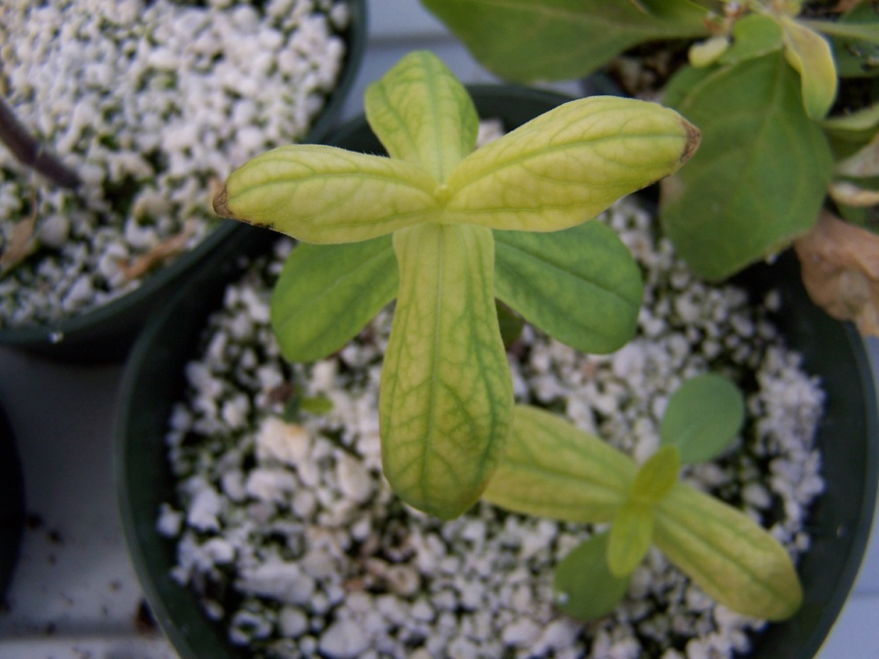
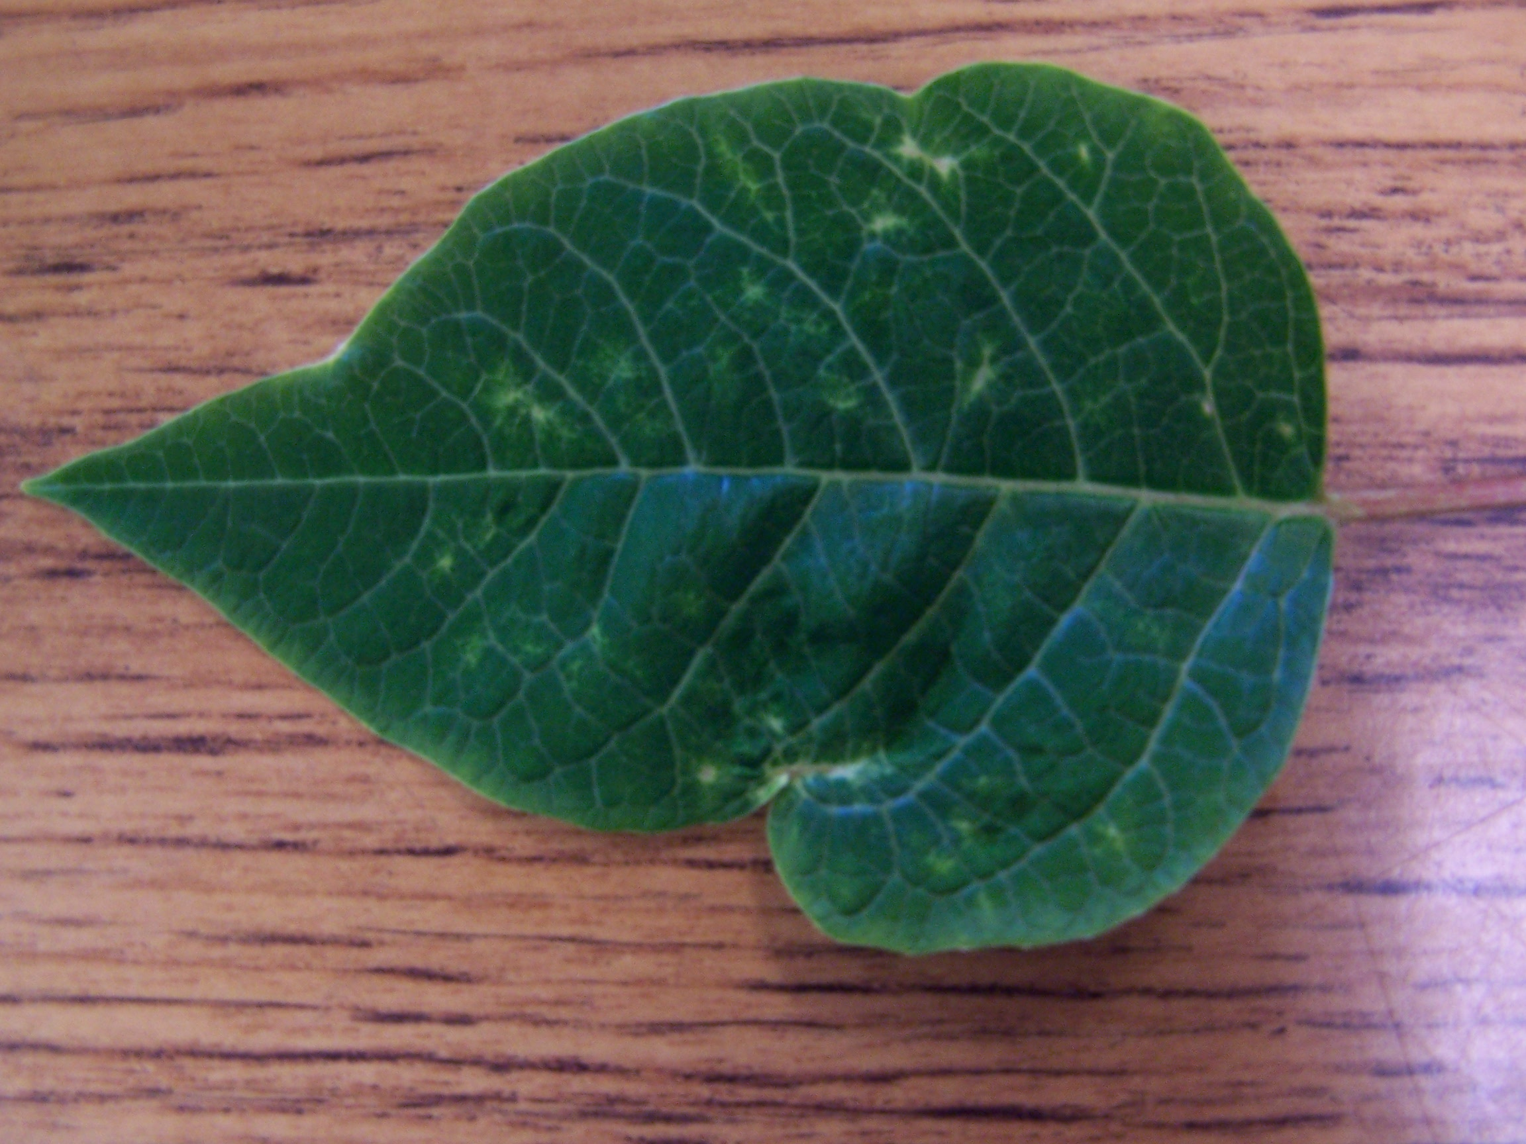
Dr. Robert w. mcmahon associate professor emeritus ohio state ati

Slide 3
Problems with ornamental plants and tips how to prevent and TREAT them
COMMON INSECT PESTS
APHIDS
SCALE
MEALYBUGS
TWO-SPOTTED SPIDER MITES
WHITEFLIES
WESTERN FLOWER THRIPS

Slide 4
Problems with ornamental plants and tips how to prevent and TREAT them
COMMON DISEASES
PYTHIUM ROOT ROT
RHIZOCTONIA STEM AND ROOT ROT
BOTRYTIS BLIGHT

Slide 5
Problems with ornamental plants and tips how to prevent and TREAT them
COMMON NUTRIENT DEFICIENCIES
NITROGEN
IRON
MAGNESIUM
PHOSPOROUS

Slide 6
APHIDS
Aphids are arachnids and are pests on both indoor and outdoor plants, including herbaceous and woody plant species.
Aphids have plump, pear-shaped bodies and can vary in color from green to black.
These pests have piercing sucking mouth parts that are inserted into plant cells, removing the contents.
Aphids typically are found on new, tender growth and flower buds, causing deformed growth.
As Aphids increase in size, they molt and cast off their skins, which appear as white flecks on foliage and stems.

Slide 7
APHIDS
As aphids feed, they secrete a sticky, clear substance called honeydew that accumulates on plant surfaces beneath them.
After a period of time, a black sooty mold grows on the sticky honeydew, further reducing the aesthetics of the plant.
Aphids bear live young and thus, can multiply rapidly and build up large damaging populations quickly!
Control strategies include inspecting plants before purchasing, releasing biological control agents, and applying horticultural oils and soaps to the pests.
If isolated on a portion of the plant, you can just prune off the infested portion and dispose it if the overall appearance of the plant is not compromised.

Slide 8
Adult aphid and recently born Aphid infestation and cast-
offspring off skins

Slide 9
Heavily-infested Easter lily bud Honeydew secretion on a fig leaf
Note the cast-off skins of the
aphids

Slide 10
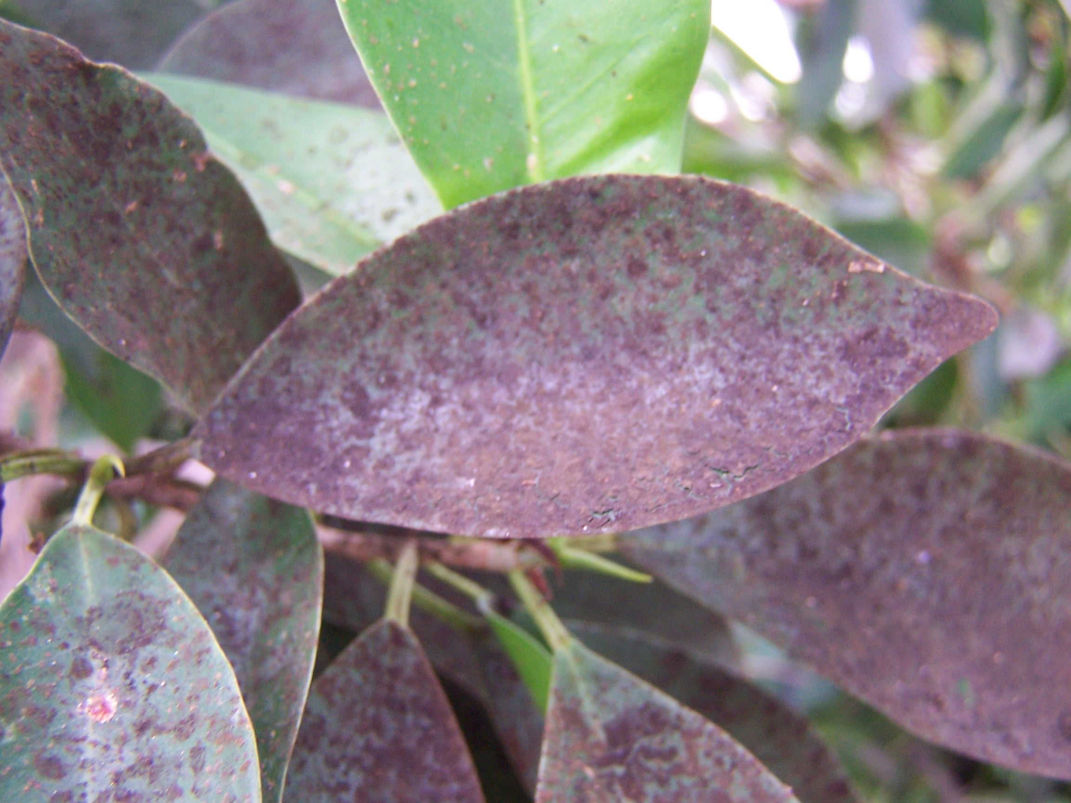
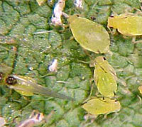
Black sooty mold growing on Winged adult aphids appear
honeydew on a fig leaf when populations become
overcrowded, and winged
adults fly to infest new
plants.

Slide 11
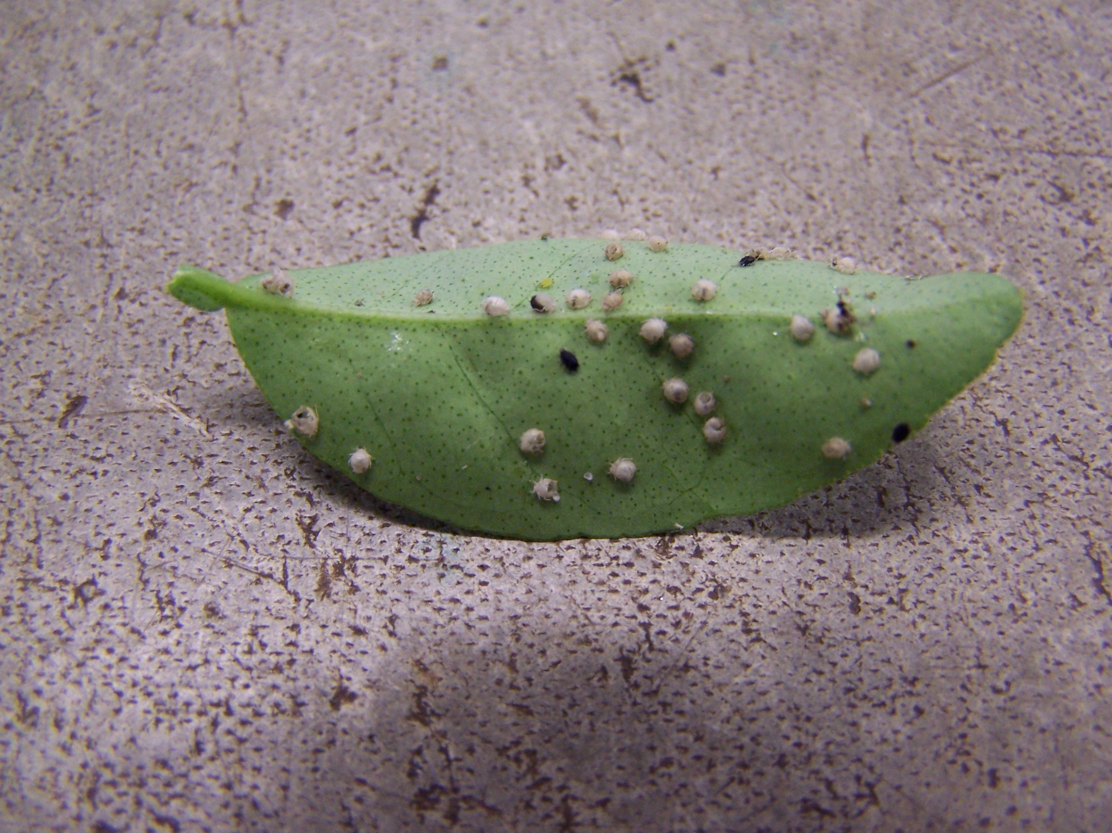
Parasitized aphids by wasps on a fig leaf-note emerging wasp!

Slide 12
Scale
Scale are oval-shaped insects that are covered with a protective wax structure that usually are oval and dome shaped, hence giving this pest its common name.
These pests are found on both herbaceous and woody plants.
Females lay eggs that then hatch into a larval form or “crawler” that seeks a suitable spot to settle and start feeding.
Scale have needle-like mouthparts that are inserted into plant tissue to remove the sap.
Scale typically feed adjacent to or on veins on herbaceous foliage to easily obtain nutrient-rich sap.

Slide 13
Scale insects feeding on a palm frond and fig leaf. Note how the
Scale are positioned adjacent or on the larger veins of the fig
leaf and are in rows on the palm frond stem. They are aligned
with the phloem elements, which carry nutrient rich sap.

Slide 14
Scale
Scale feeding damage includes chlorotic leaves, deformed foliage and defoliation with heavy infestations.
Indirect feeding damage is the secretion of honeydew that accumulates on foliage beneath the scale, upon which black sooty mold grows, further ruining plant appearance.
Prevent scale by carefully inspecting plants before purchasing, if possible, and keeping plants healthy to better fend off infestations.
Control by applying horticultural oils or soaps or, with minor infestations, removing scale with a Q-tip soaked in rubbing alcolhol.
Lady beetles and parasitic wasps also may be used to control scale infestations.

Slide 15
Mealy bugs
Mealy bugs are small oval insects that are covered with a white, cottony-like waxy coating that feed mainly on herbaceous plants.
White cottony masses located by the adults contain the eggs of this pests.
House plants and citrus are common targets for feeding, whereby the adults insert their mouthparts into plant tissue, removing sap from the cells. Some species feed on roots!
Distorted new growth, foliage chlorosis and even death of the plant is possible.
Honeydew and associated black sooty mold also appear on foliage.

Slide 16
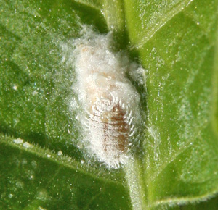
An Adult mealy Infested foliage showing Dead foliage due to
bug with egg adults and egg masses mealy bugs
mass next to it

Slide 17
Mealy bug CONTROL
Inspect plants for mealy bugs before purchasing and quarantine new plants, if possible, before planting or placing in the home.
If infestations are limited to just a portion of a plant, simply prune that part of the plant and dispose, if the appearance of the plant won’t be adversely affected.
Apply horticultural oils or soaps to kill adults and juvenile stages.
Remove adults with a Q-tip dipped in rubbing alcohol for minor infestations.
Biological agents are available, such as predatory wasps and a “mealy bug destroyer” or Cryptolaemus montrouzieri, a type of beetle.

Slide 18
SPIDER MITES
Spider mites are tiny arachnids that feed on foliage of many species of plants, both herbaceous and woody.
The adults appear as tiny moving dots, located primarily on the undersides of leaves.
Adults feed by inserting their piercing mouthparts into plant tissue, sucking out the contents.
Foliage takes on a classic stippled or mottled appearance and under instances of heavy infestations, adults will literally cover infested foliage with webbing!
Dry, warm conditions favor spider mite infestations.

Slide 19
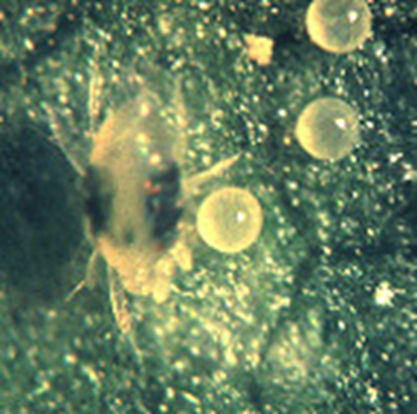
Adult two-spotted spider Heavy spider mite infestation
mite with eggs on leaf showing mottled leaf
underside

Slide 20
Mottled palm frond from spider Adult spider mites and webbing
mite feeding underneath foliage on heavily infested leaf

Slide 21
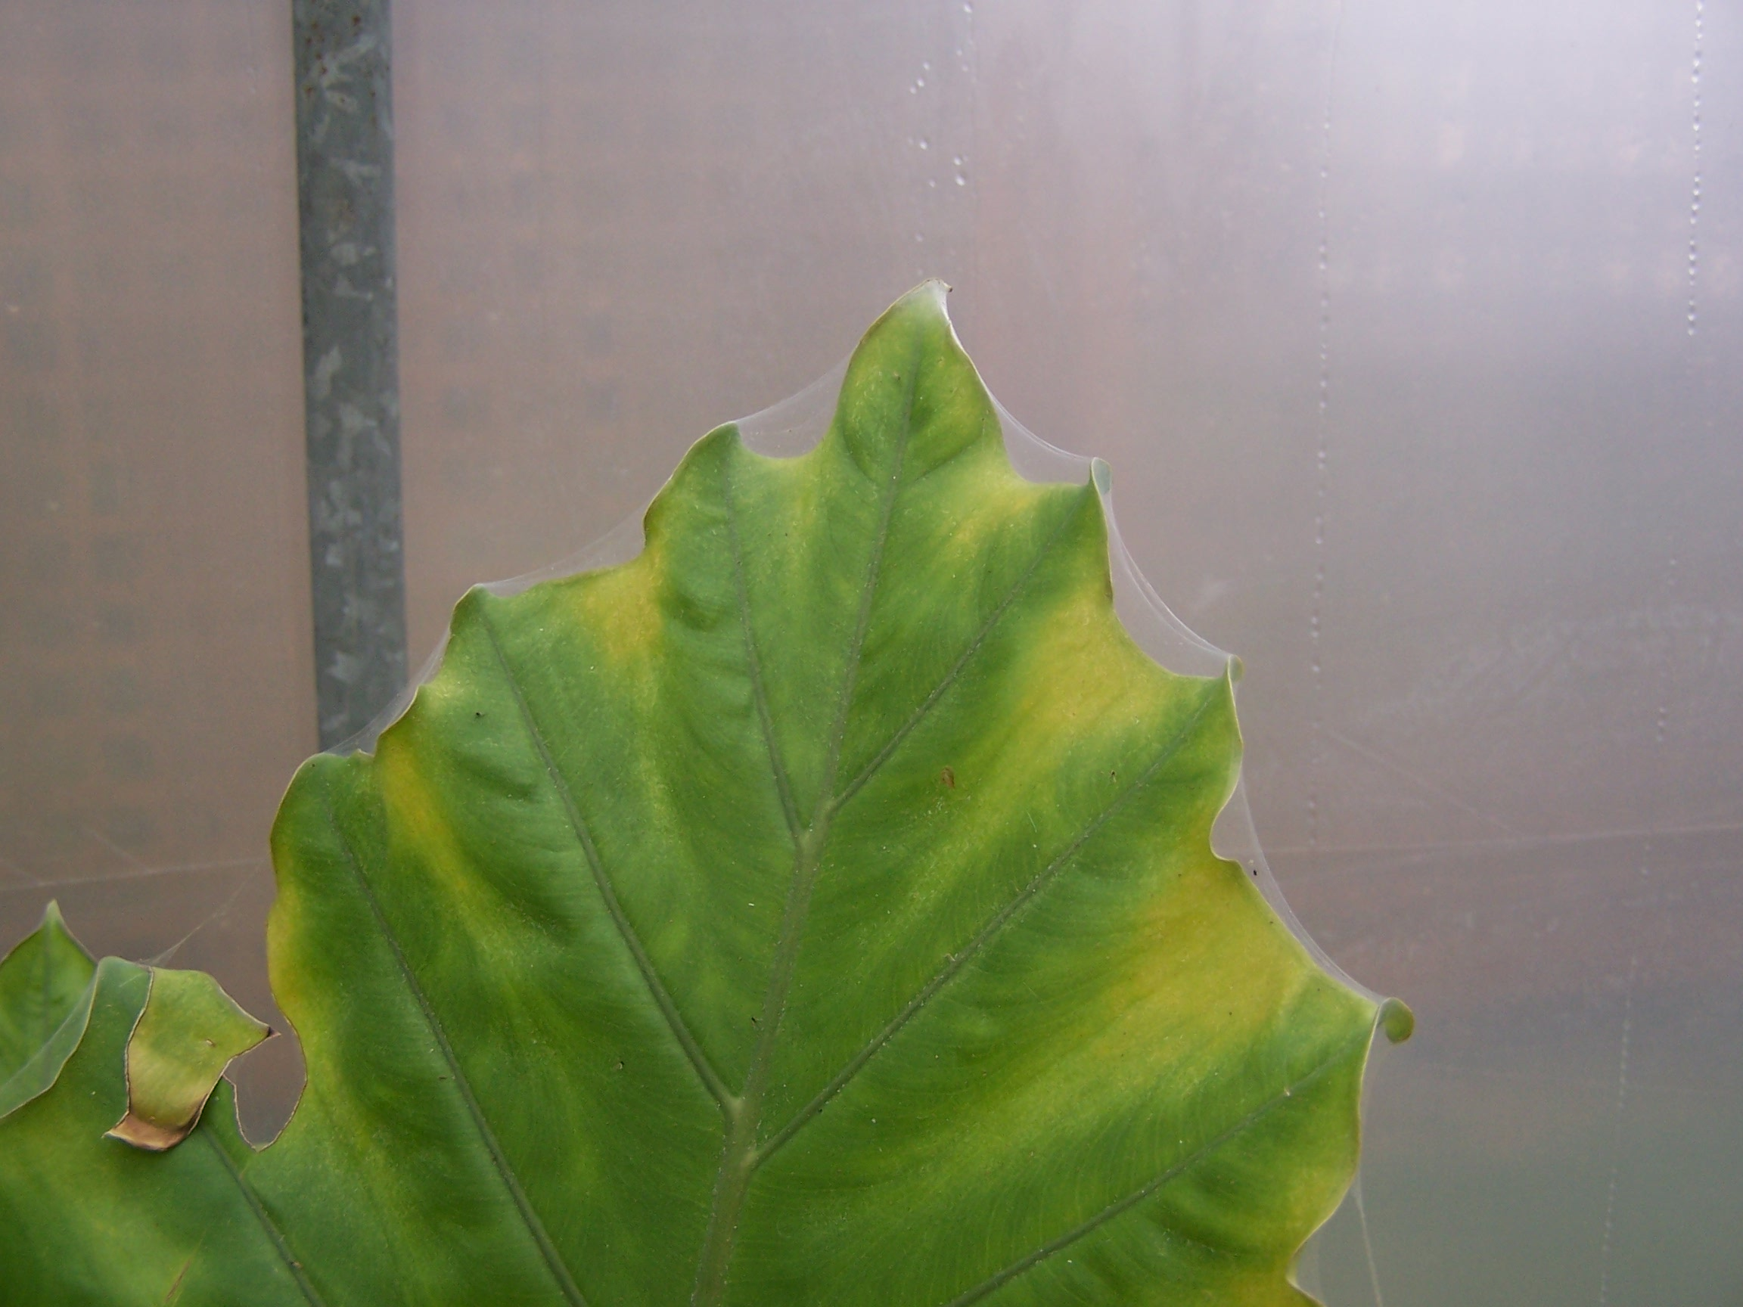
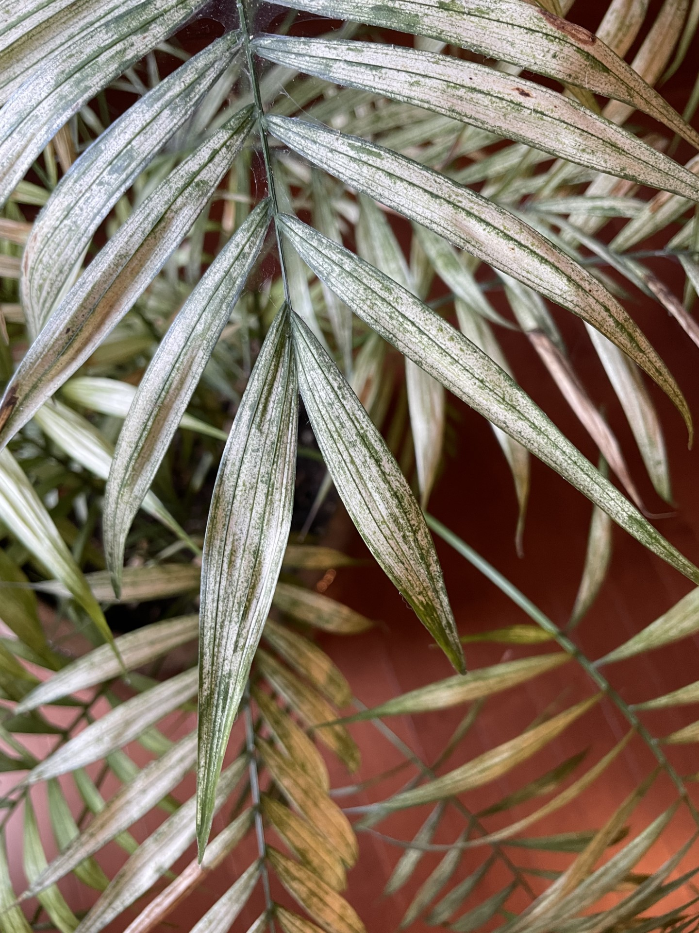
Alocasia leaf with webbing due Extreme mottling on a
to a heavy spider mite infestation palm frond

Slide 22
SPIDER MITE CONTROL
Spider mites may be controlled by simply spraying infested areas of the plant with water, spraying the undersides of the leaves. Repeat weekly for several weeks until mites are not detected.
For webbed-over plants, discard infested plants by placing in a bag to transport for disposal.
You may also apply horticultural soaps and oils to combat infestations.
Biological control by predatory mites can be effective, provided populations of the mites are low, requiring frequent inspection of plants to detect early infestations.

Slide 23
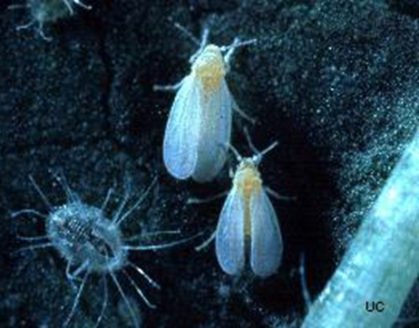
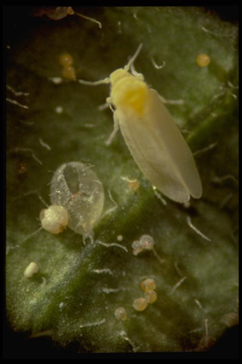
Whiteflies
Whiteflies are small white/whitish insects that infest a wide variety of herbaceous and woody species. Poinsettias and many vegetable crops are especially vulnerable.
The greenhouse whitefly and sweet potato whitefly are the two species most commonly infesting ornamental and vegetable crops.
Greenhouse WFs and larval stage Sweet potato WF adult
White horizontal wings over bodies Angled yellowish wings

Slide 24
Whiteflies
Whiteflies have piercing sucking mouthparts that are inserted into leaf tissue, sucking out the sap.
Whiteflies feed primarily the undersides of leaves.
Adults also lay their eggs on leaf undersides which hatch into larva that feed on the leaves.
As with other pests feeding on sap, whitefly adults secrete honeydew that coats leaves below, with black sooty mold growing on the honeydew.
Inspect lower leaves for adults and larval stages and implement control measures as soon as possible: horticultural oils and soaps; biological control using Encarsia formosa, a parasitic wasp; and remove weeds that will harbor pests and pathogens!

Slide 25
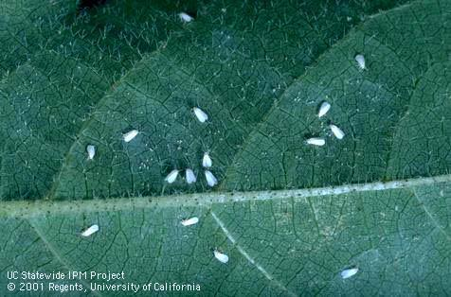
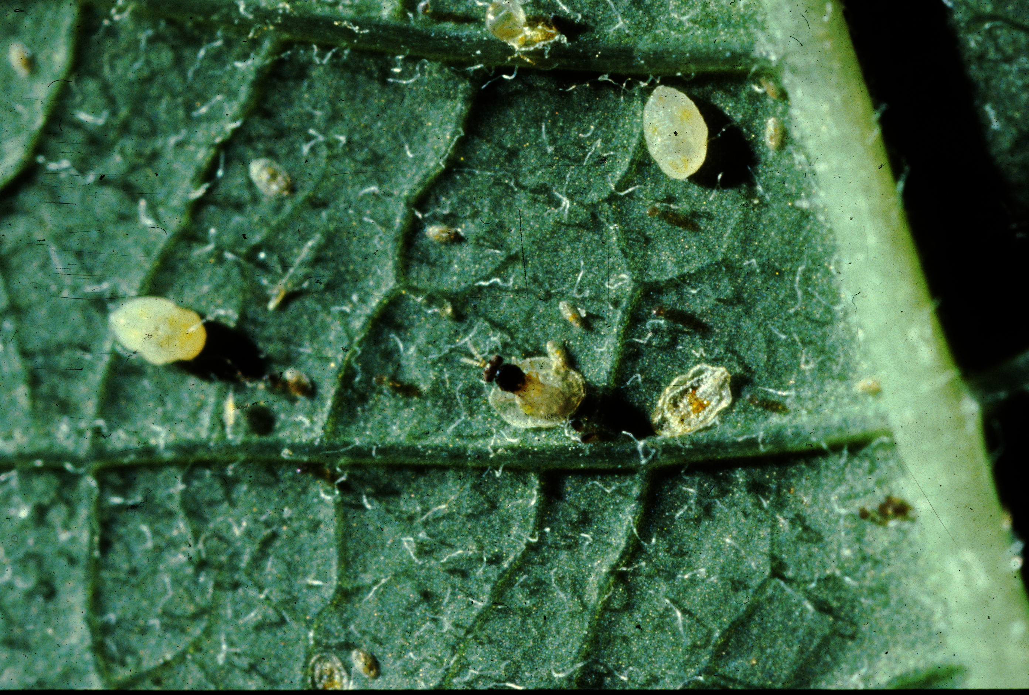
whiteflies
Greenhouse WF adults feeding An Encarsia formosa wasp
on the underside of a leaf parasitizing a WF larval stage

Slide 26
Western Flower Thrips
Western flower thrips are the most serious pest of almost all greenhouse flower crops and also infesting many vegetable crops, grasses, and fruit crops.
Adults are tiny (1/16”), winged, yellowish/brown colored, and cylindrically shaped.
Adults use their mouthparts to scrape immature leaf/petal surfaces and feed on the sap that emerges.
Visible damage includes distorted/twisted petals and leaves, and puncture marks surrounded by discoloration.
These pests are challenging to control as adults burrow into tight spaces, such as unexpanded leaves and flower buds to feed on young petals.

Slide 27
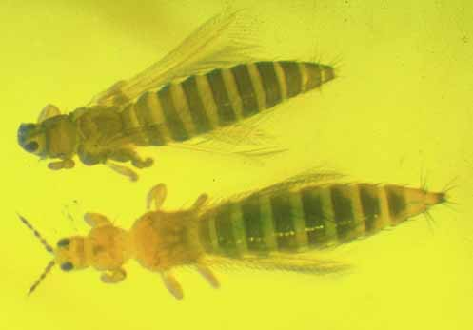
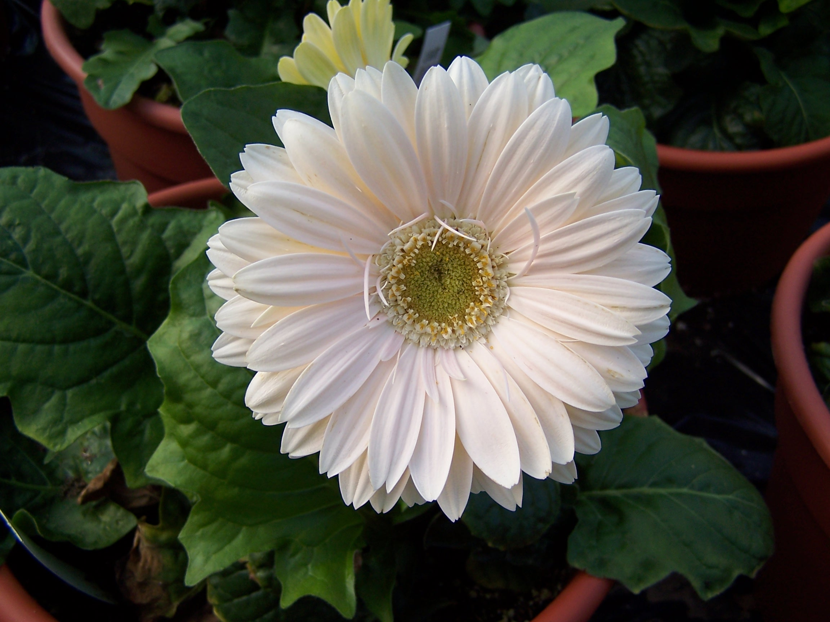
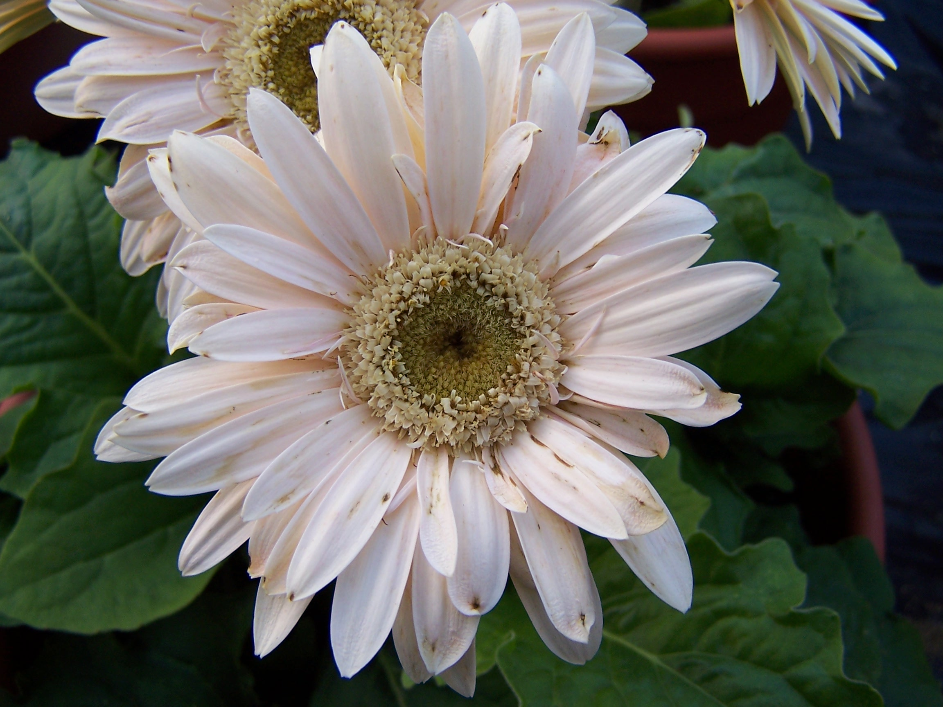
Western Flower Thrips
Adult WF Thrips Healthy gerbera WF thrips-damaged
Note the wings flower gerbera flower with
distorted petals

Slide 28
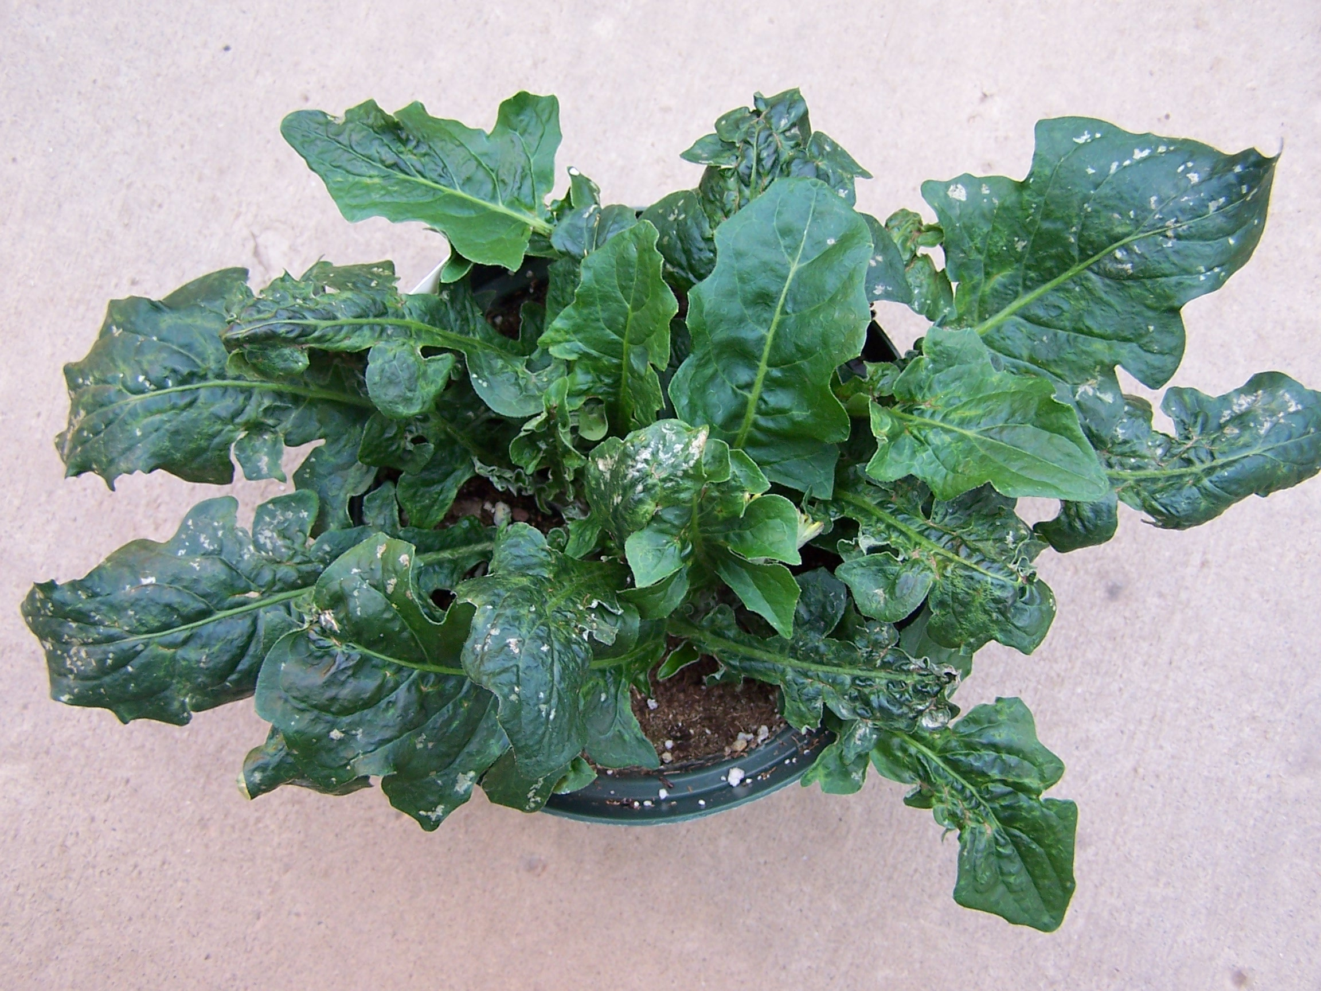
Western flower thrips
Western flower thrips’ feeding damage on a gerbera daisy plant and a poinsettia leaf. Note the deformed growth and puncture wounds surrounded by discolored tissue.

Slide 29
Western flower thrips
Western flower thrips also transmit deadly viral diseases, such as the tomato spotted wilt virus and the impatiens necrotic spot virus, for which there is no cure!
Remove all weeds as WF thrips will colonize them, serving to reinfest garden and greenhouse crops after control measures are implemented.
Screen greenhouse vents to prevent adults from entering.
Biological agents are available, such as predatory mites and nematodes that consume pupae in the soil.
Horticultural oils and soaps can provide control, but need to be applied diligently over time to kill emerging larval stages from buds and immature leaves.

Slide 30
Pythium root rot
Pythium root rot is a fungal disease caused by the Pythium pathogen.
There are several species of Pythium that attack plant roots and are ubiquitous or present nearly in all soils.
This pathogen is favored by cool wet conditions from poorly drained soil and overwatering (manually or from rains) and overfertilizing that damages root tip, allowing the pathogen to enter.
Poor sanitary practices also favor this pathogen, such as not disinfecting tools and containers after use, not sealing unused potting soil, etc.

Slide 31
PYTHIUM ROOT ROT
Plants infected with Pythium initially are stunted in growth, since the damaged roots have reduced capacity to take up nutrients for healthy growth.
Foliage can become chlorotic due to lack of nutrients required to manufacture chlorophyll.
The classic root symptom is the outer covering—or cortex—of the root becomes brownish and mushy which easily is pulled off, leaving the thread-like core or stele of the root exposed.
Wilting and death of the plant will occur if the disease is not controlled.

Slide 32
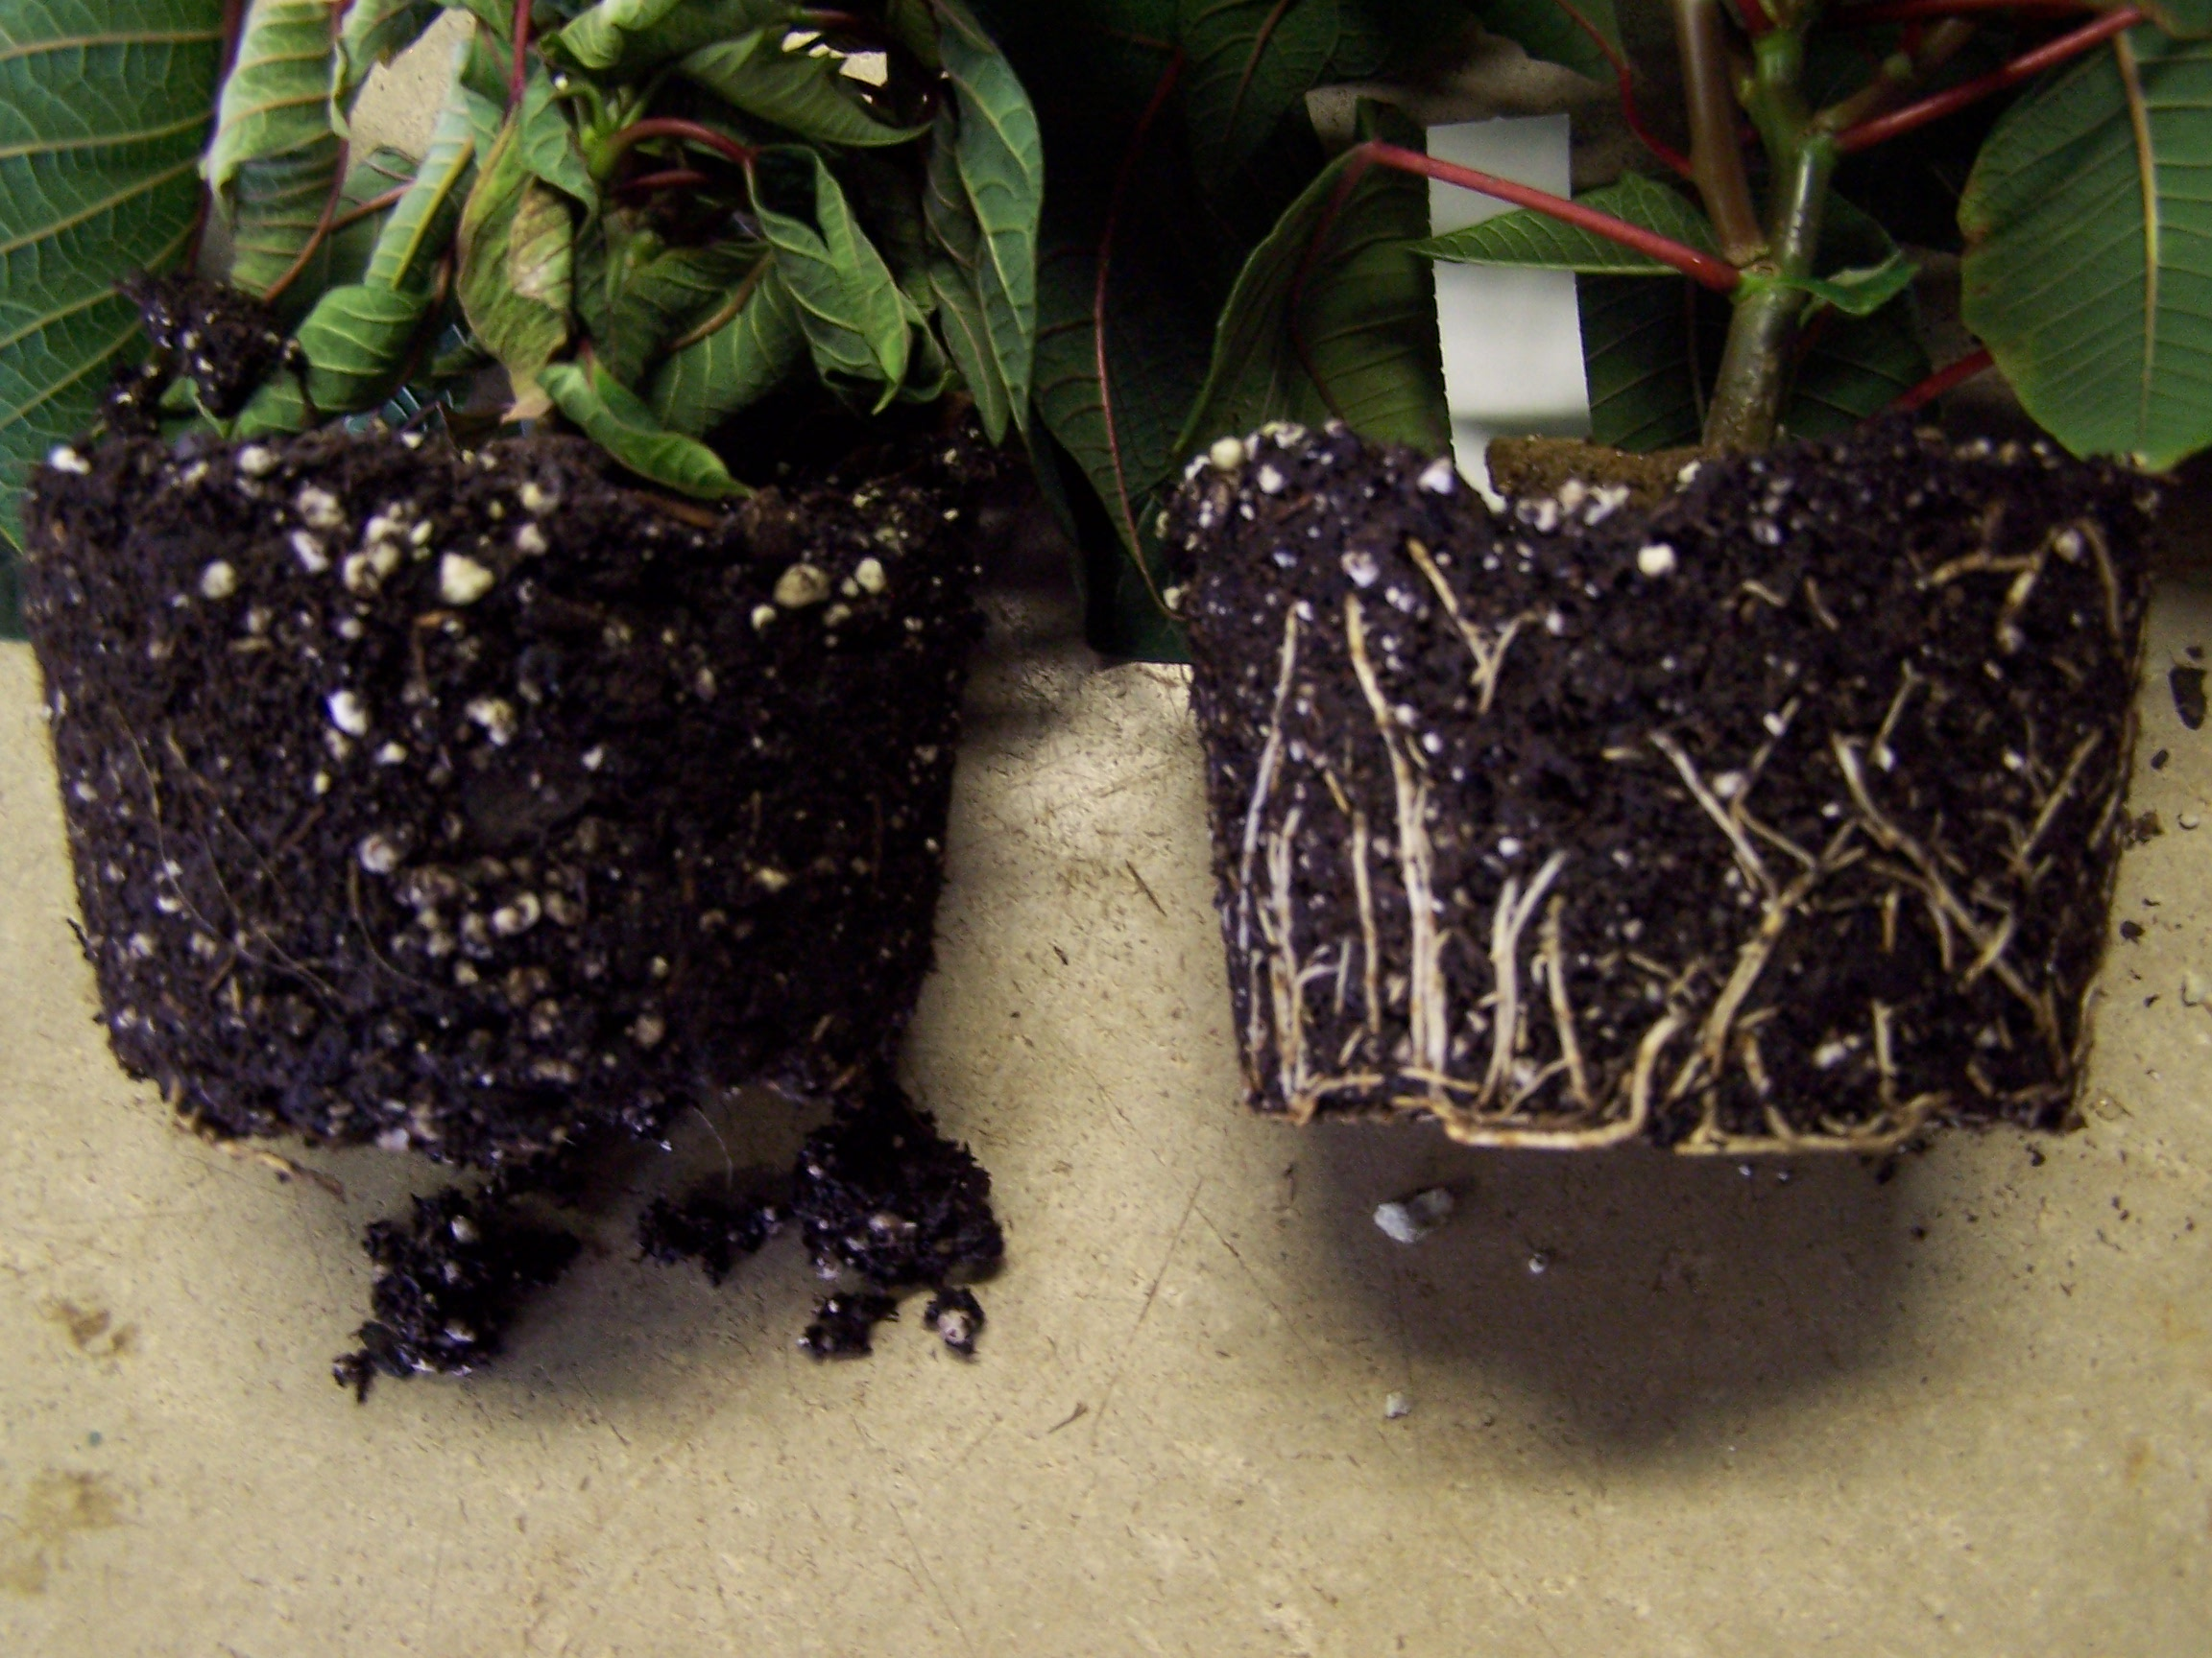
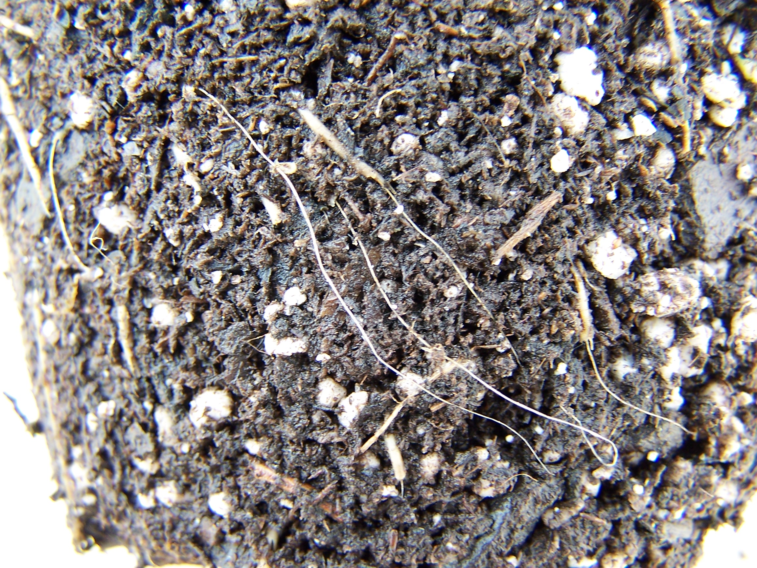
Pythium root rot
Diseased root ball left, healthy Diseased roots with the root ball on the right cortex sloughed-off and
thread-like stele exposed

Slide 33
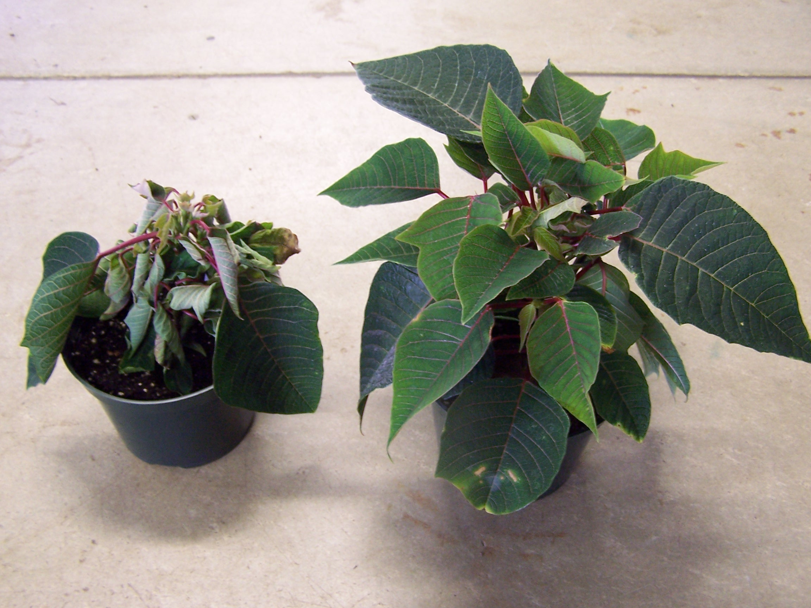
Pythium root rot

Slide 34
Rhizoctonia stem & Root rot
Rhizoctonia stem & root rot is caused by the fungal pathogen, Rhizoctonia.
Like Pythium root rot, wet soils favor the development of this disease. Warm wet soils especially promote this disease.
Poor sanitary practices easily spread the pathogen, reusing soil, and containers, tools, etc. without disinfecting them.
The fungus attacks the stem at/near ground level, usually spreading to the roots.
The base of the stems turn a dull tan or brown color, and roots discolor.
Defoliation, wilting and eventual death of the plant occurs.

Slide 35
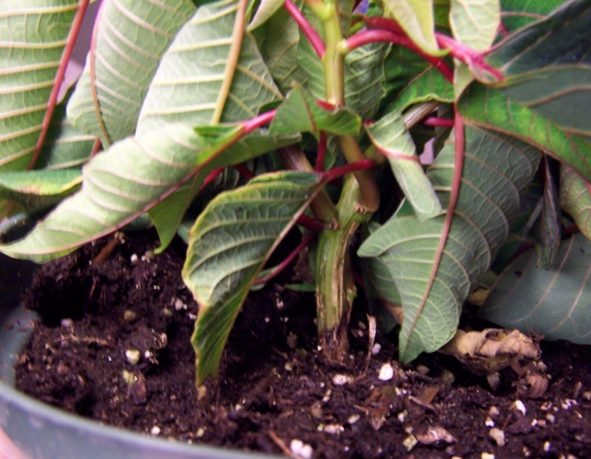
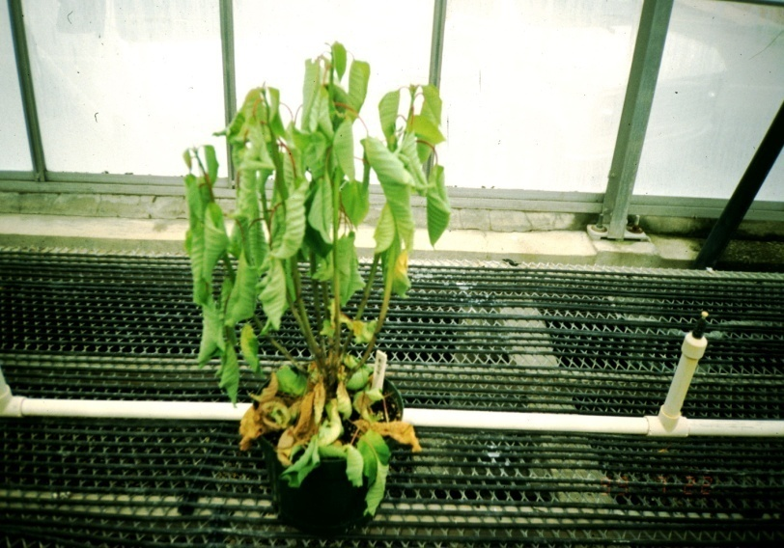
Note the rotting brown stem and This poinsettia stock plant
wilting leaves caused by literally collapsed overnight due
Rhizoctonia stem & root rot Rhizoctonia infecting the plant.

Slide 36
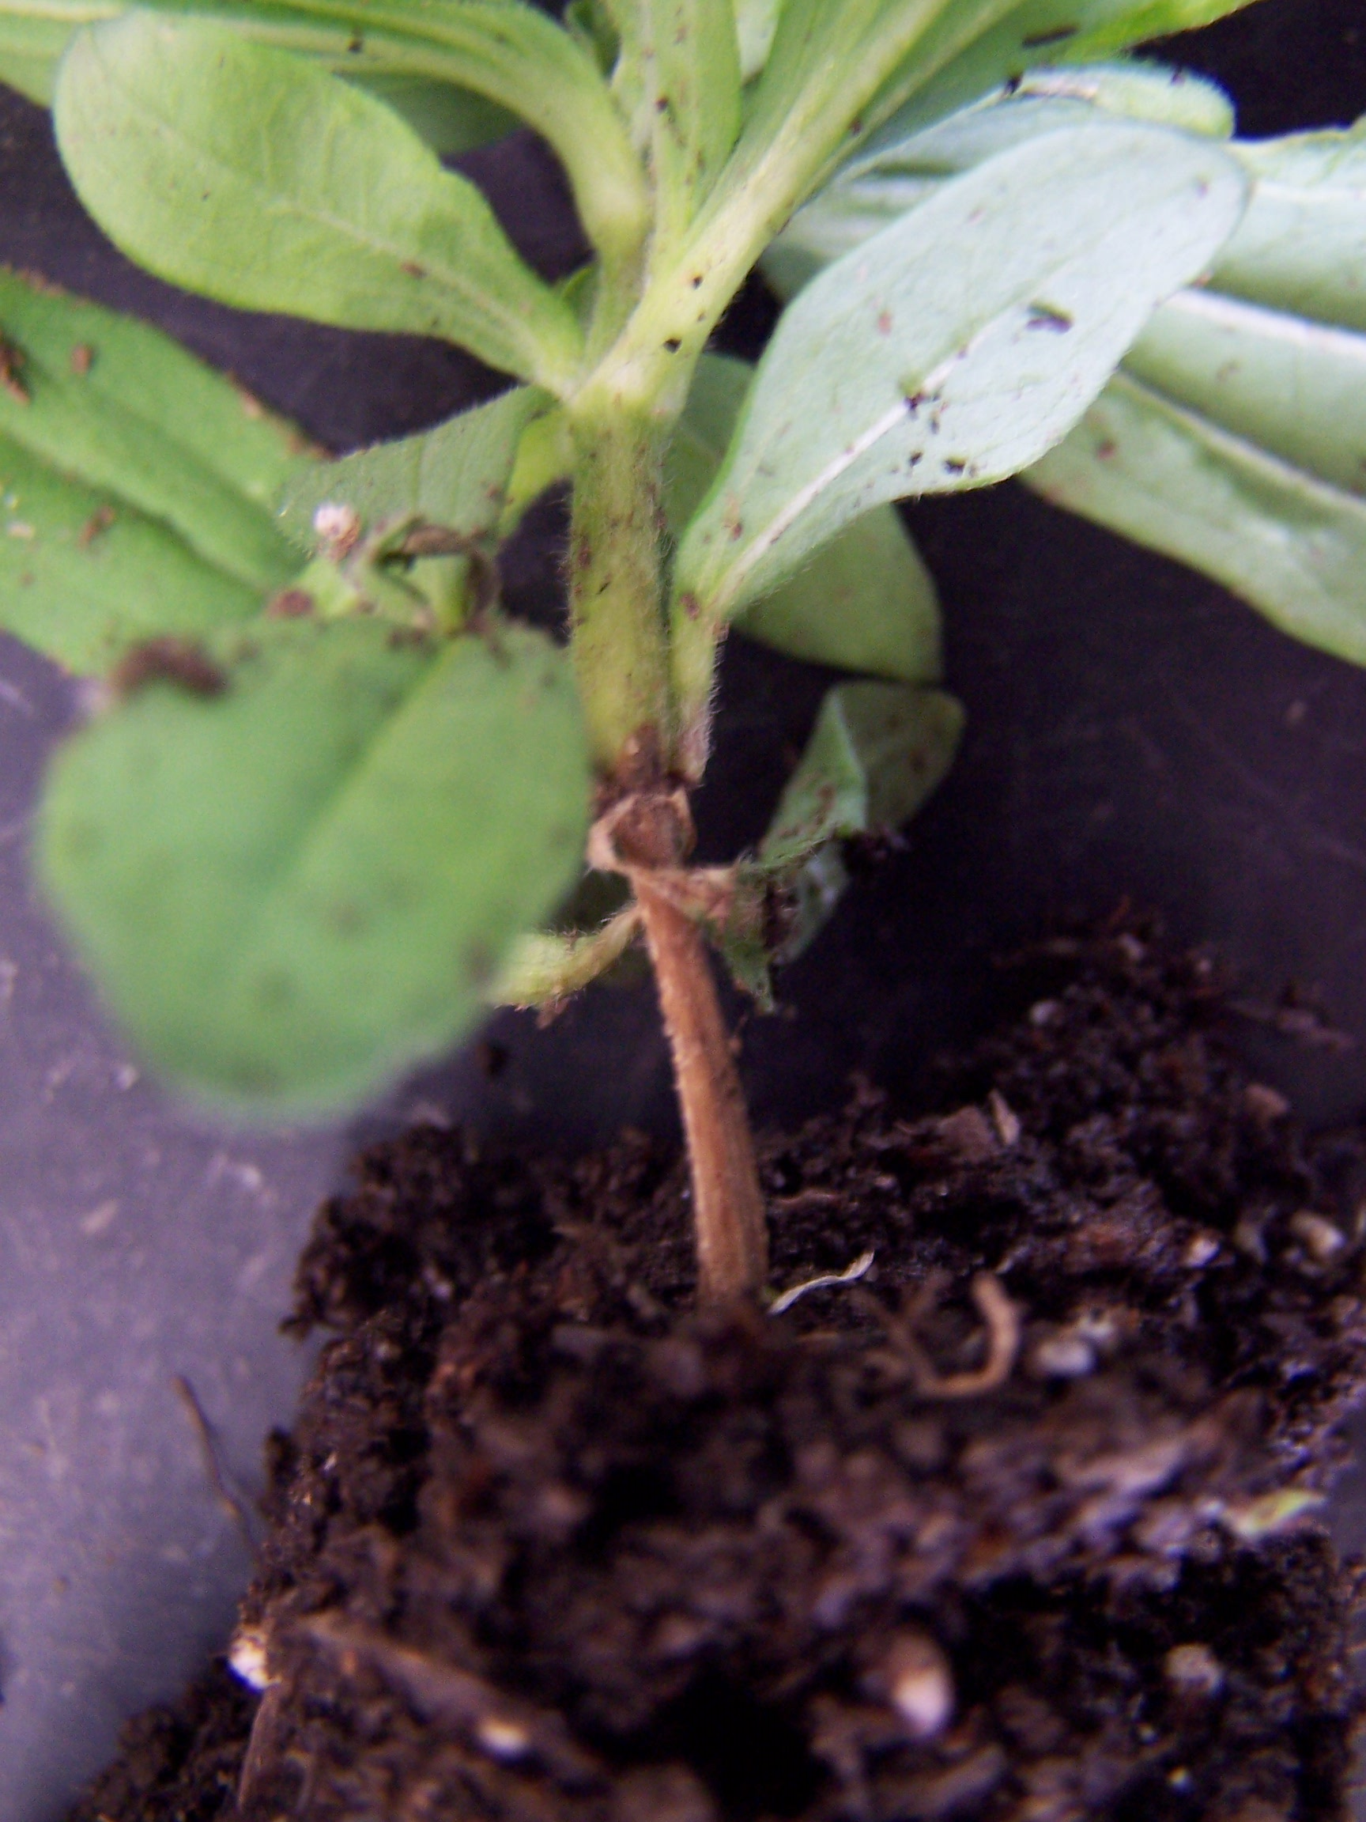
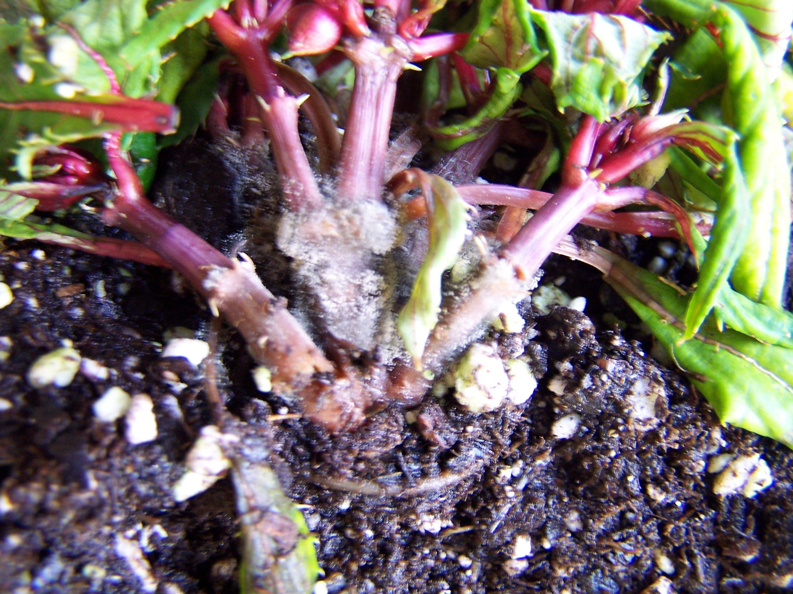

Slide 37
PREVENTION/CONTROL OF ROOT AND STEM ROTS
SANITATION! Make sure all work surfaces, containers, tools, etc. have been sanitized before use! Wash your hands!
Keep potting soil covered to prevent contamination from insects and pathogens; pasteurize soil if possible for 30 minutes between 140ºF and 160ºF to kill harmful organisms.
Do NOT overwater, allowing the soil to dry between waterings, if possible.
Use a well-drained soil or amend heavy soils with coarse sand, etc. to promote better drainage.
Purchase disease-free cuttings and/or disease-resistant plants.

Slide 38
PREVENTION/CONTROL OF ROOT AND STEM ROTS
For Pythium, research has shown that maintaining the soil pH around 5.5 will reduce infections.
Incorporating composted pine bark at 20% of the root medium volume will inhibit Pythium.
Biocontrol agents, such as Trichoderma harzianum (fungus), are available that control both pathogens.
Drench soil with conventional fungicides.
Provide an ideal growing environment to promote vigorous growth to better fend off pathogens.

Slide 39
Botrytis BLIGHT
Botrytis Blight or Gray Mold is a common fungal foliar disease that affects a wide variety of ornamental plants.
Just about any part of the plant is susceptible, except for the roots.
The fungus infects both dead and living plant tissue and is favored by cool, wet conditions.
The fungal spores germinate within the thin film of water on the plant and quickly invades the plant tissue beneath.
The fungus produces masses of gray/gray-white spores that can completely cover the plant in severe infections.
Spores are airborne and are easily spread by the wind/air currents.
Infected tissue turns brown and dies.

Slide 40
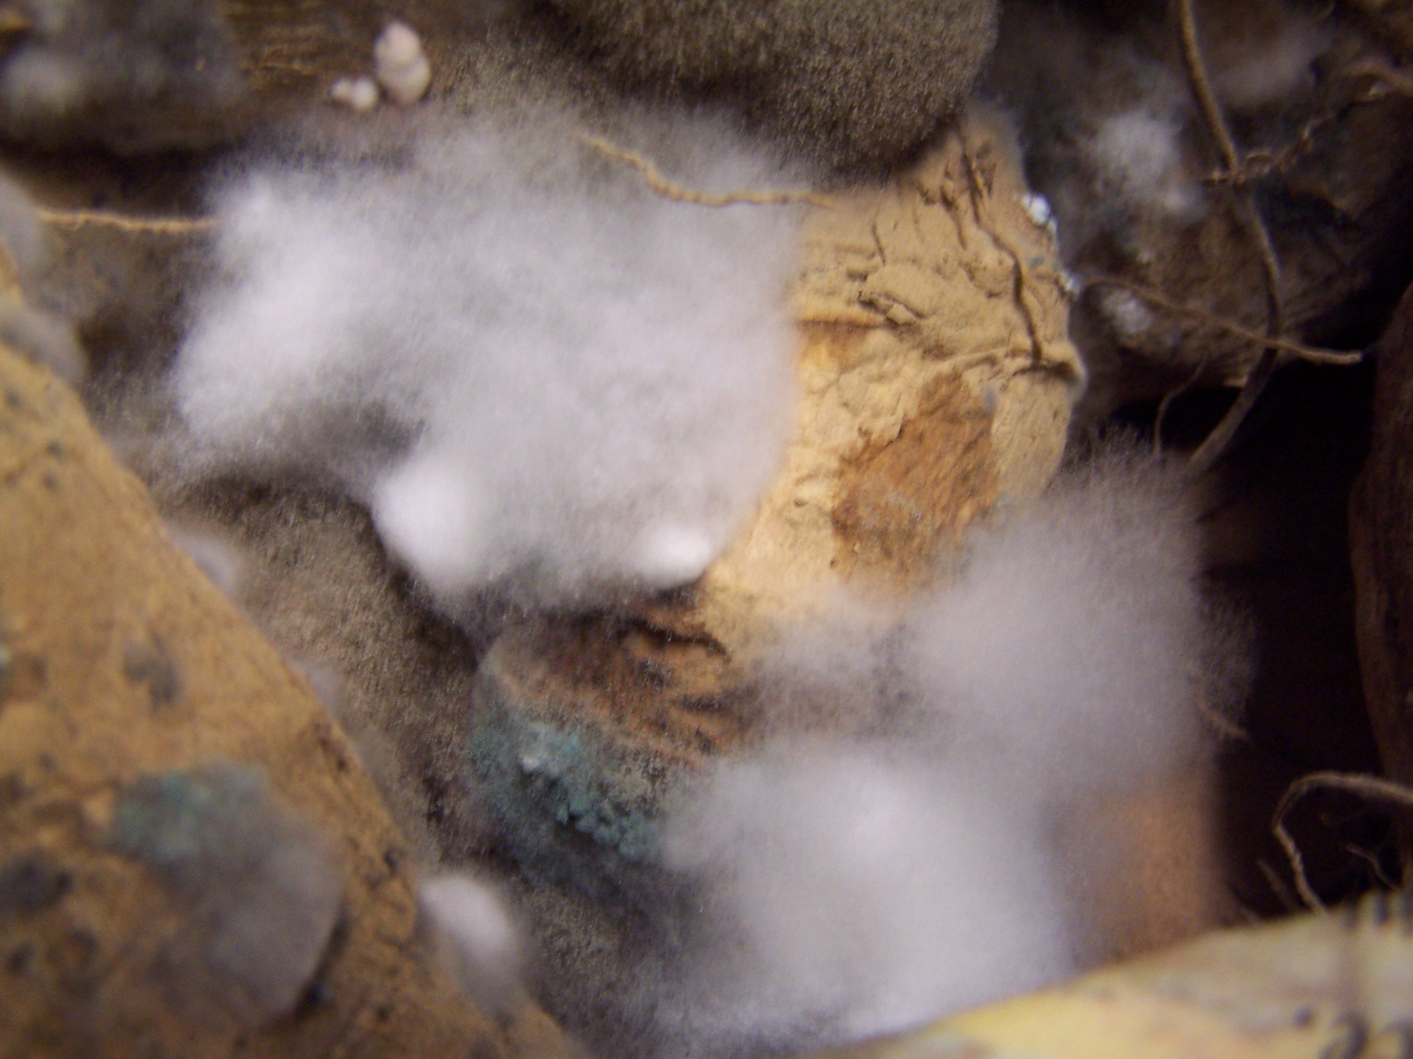
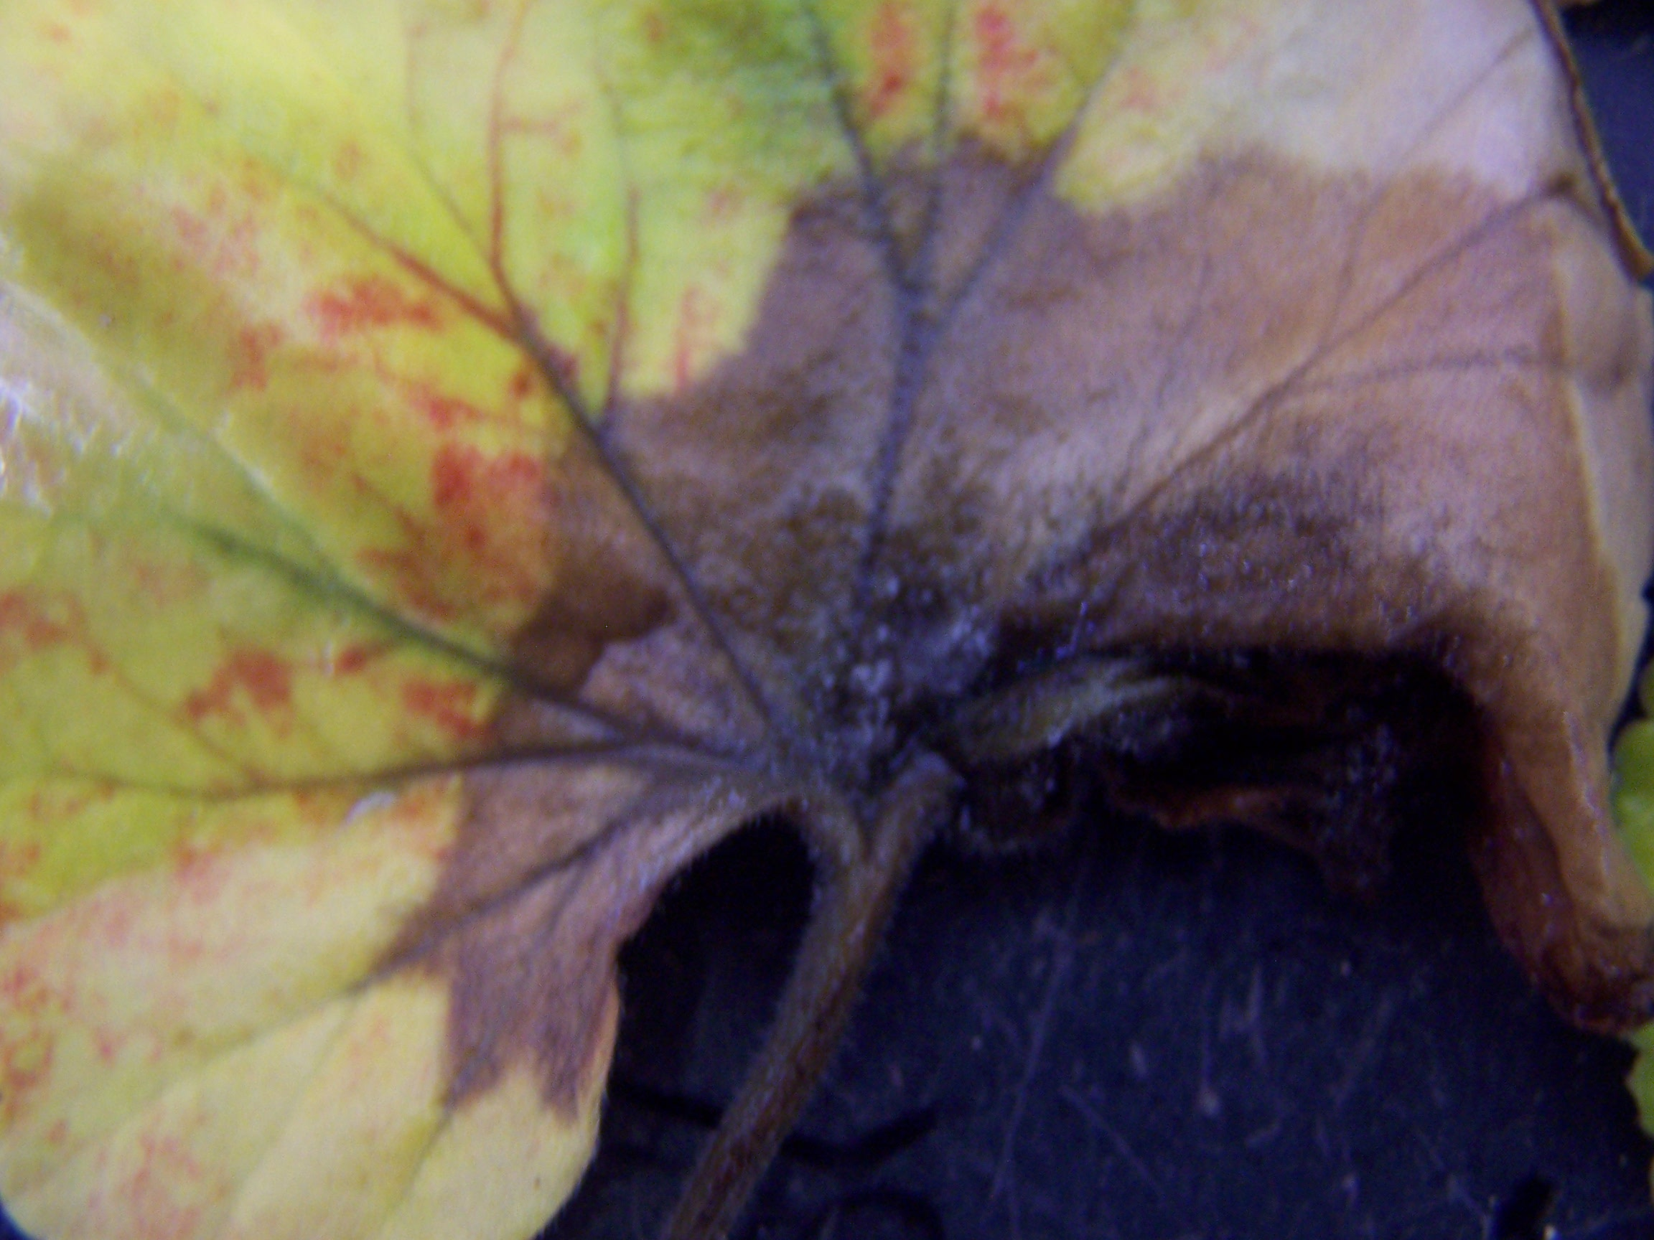
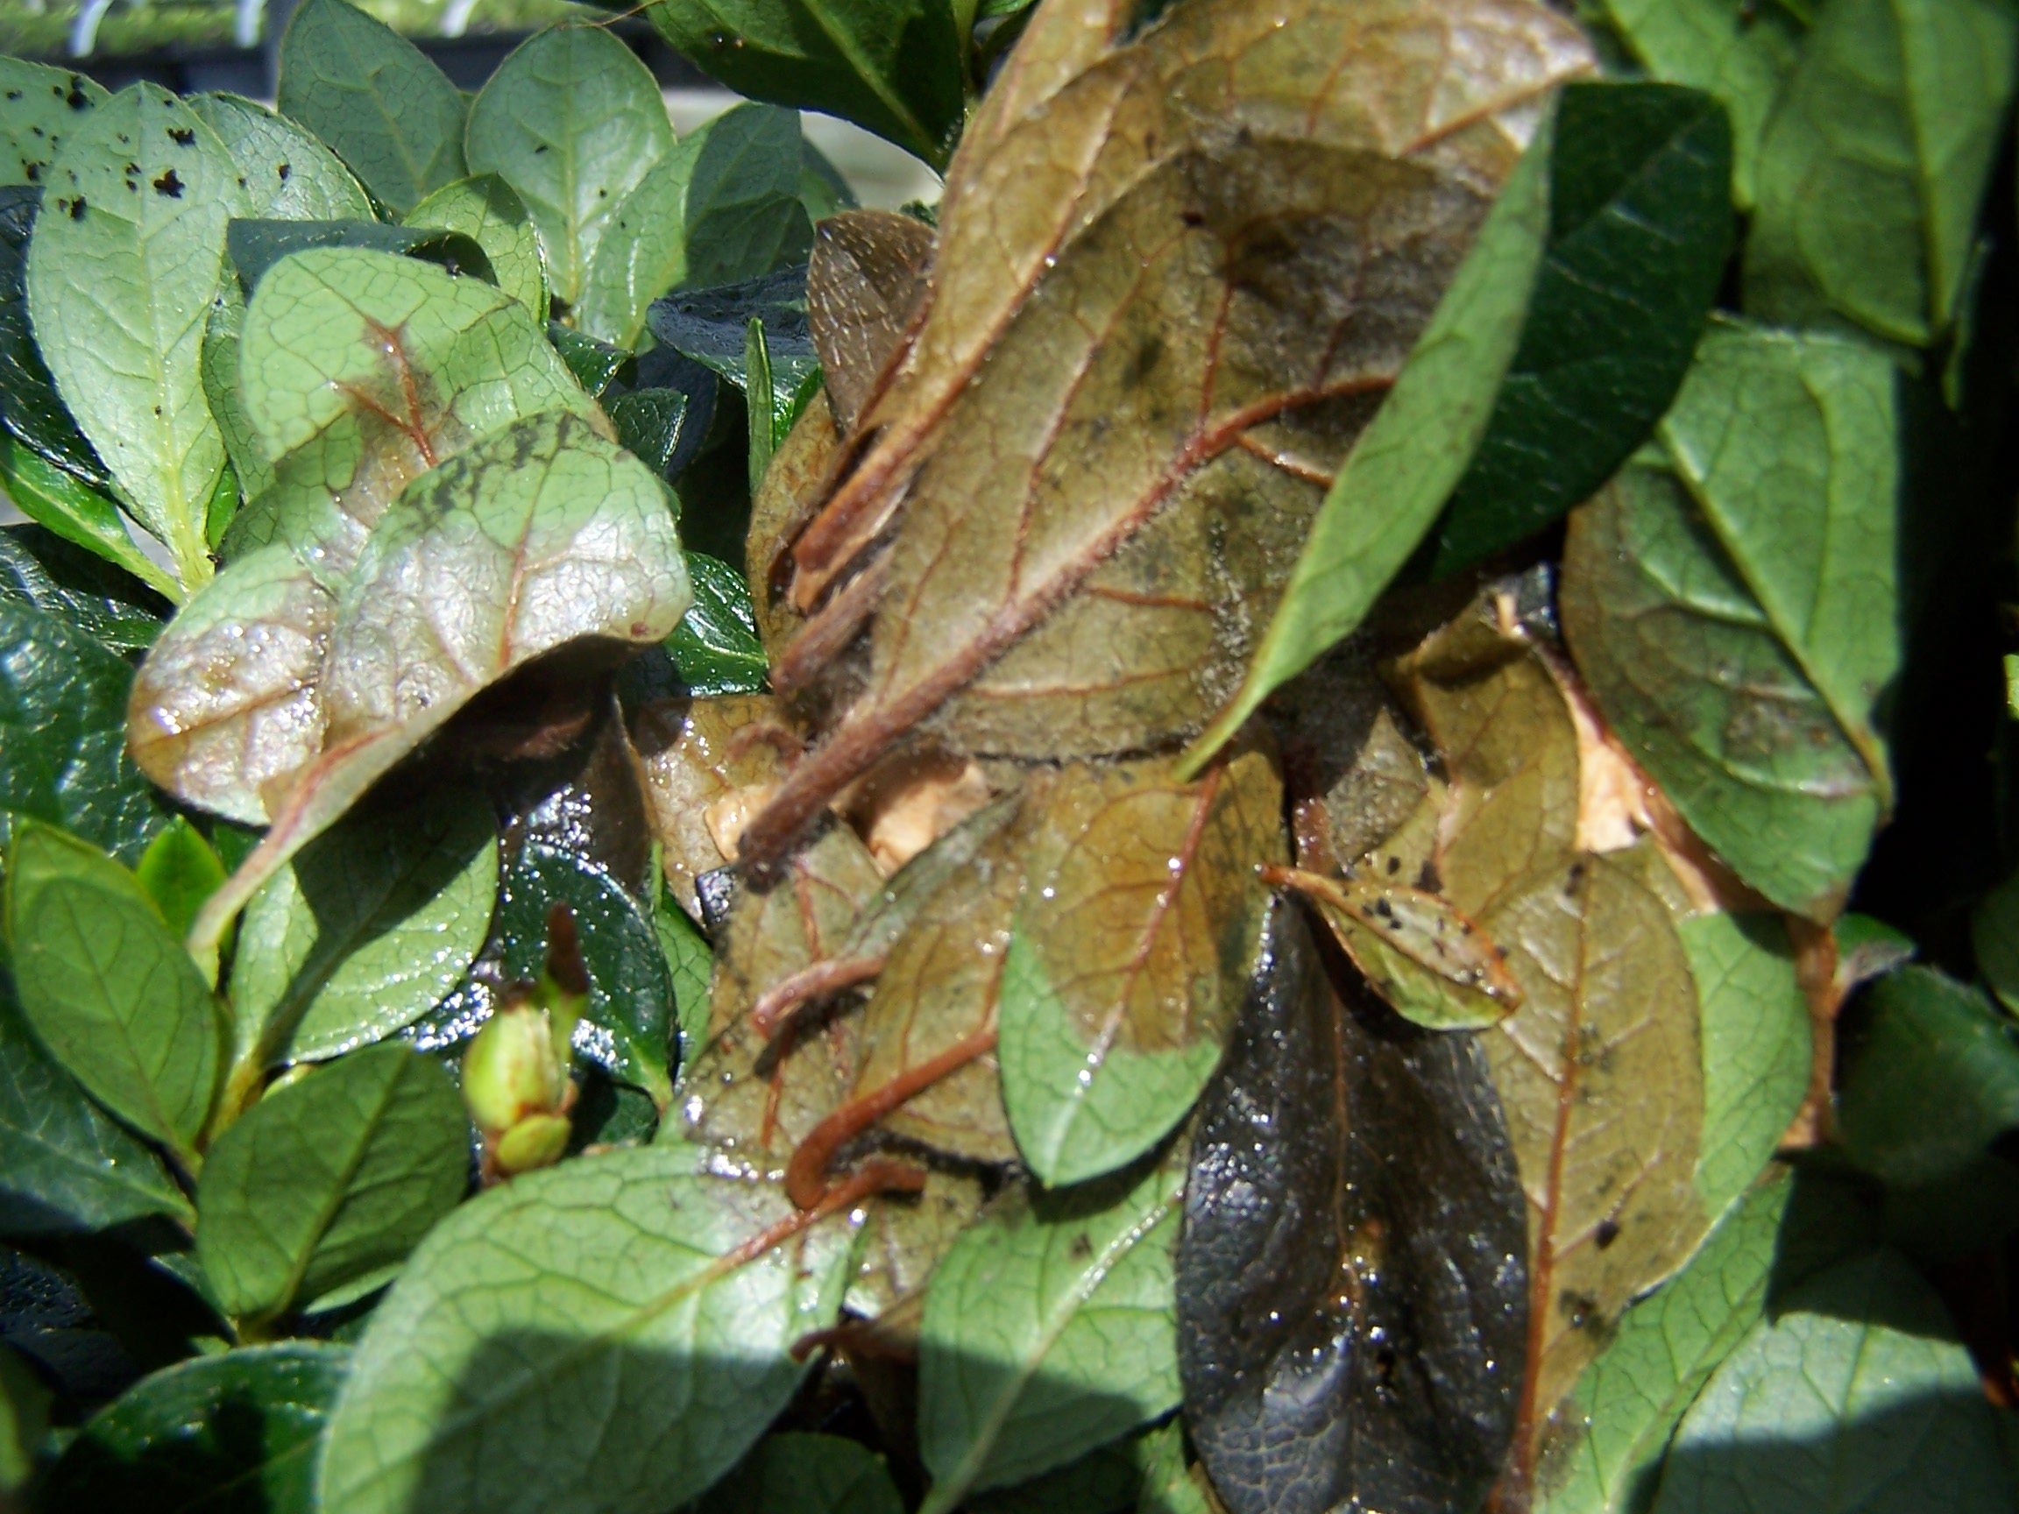
Botrytis Blight forming spores on sweet potatoes in the left photo.
The middle photo shows an infected geranium leaf with dead tissue at the base of the leaf.
The photo on the right shows wet azalea leaves infected with Botrytis.

Slide 41
Botrytis BLIGHT control
Promptly remove dead leaves, spent flowers and other debris.
Provide plenty of air circulation to keep foliage dry by properly spacing plants and try to keep the relative humidity below 85%.
When irrigating, try not to wet the foliage, especially later in the day; do not irrigate at night!
Avoid bruising/damaging plant parts as this opens up an avenue for all pathogens to invade plant tissue.
Remove infected plants by placing in a sealed bag/container to avoid spreading the spores during transport.
Apply fungicides as needed.

Slide 42
NITROGEN NUTRITION AND DEFICIENCY SYMPTOMS
Nitrogen is a macroelement, and is used by plants in the largest amount of any essential fertilizer/mineral element.
Nitrogen is required for chlorophyll biosynthesis and also for the production of amino acids that are the building blocks of proteins.
Nitrogen promotes vegetative growth.
Deficiency symptoms include an overall chlorosis that starts with the lower foliage and progresses upwards and stunted growth.
Lower leaves eventually become necrotic and fall off the plant.
Applying too much nitrogen will reduce flowering!

Slide 43
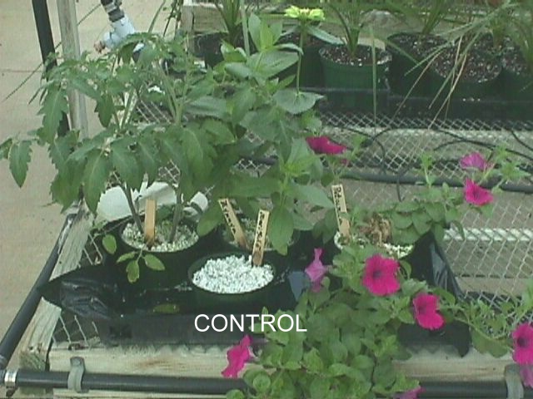
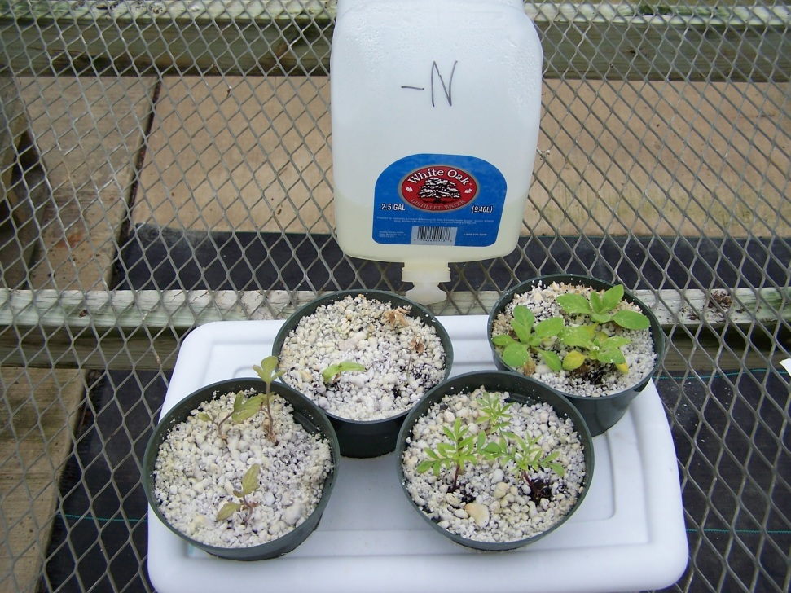
Control plants on the left after 9 weeks of growth with a complete fertilizer solution.
Nitrogen-deficient plants after 9 weeks grown with a nutrient solution lacking nitrogen. Note the badly stunted, chlorotic plants.

Slide 44
iron NUTRITION AND DEFICIENCY SYMPTOMS
Iron is a microelement and used in much smaller quantities than macroelements, but is just as important for plant health!
Iron is used for chlorophyll production, cell division, DNA synthesis and plant respiration.
Iron is not mobile within plants, so deficiency symptoms appear first in young growth.
Interveinal chlorosis occurs in the upper leaves, but if left unchecked, all leaves may be affected with leaves turning whitish in color.
Some plant species are more susceptible than others to iron deficiency, such as azaleas, gardenias, petunias, calibrachoa, pansies and citrus.

Slide 45
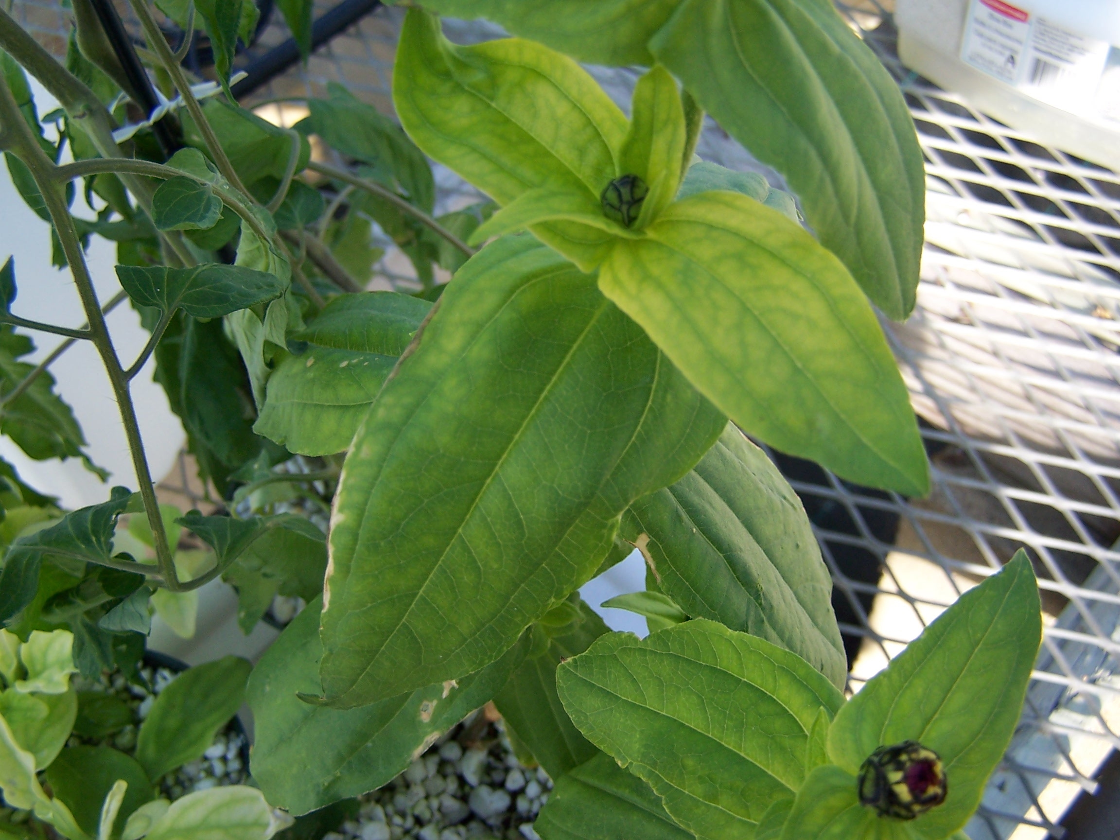
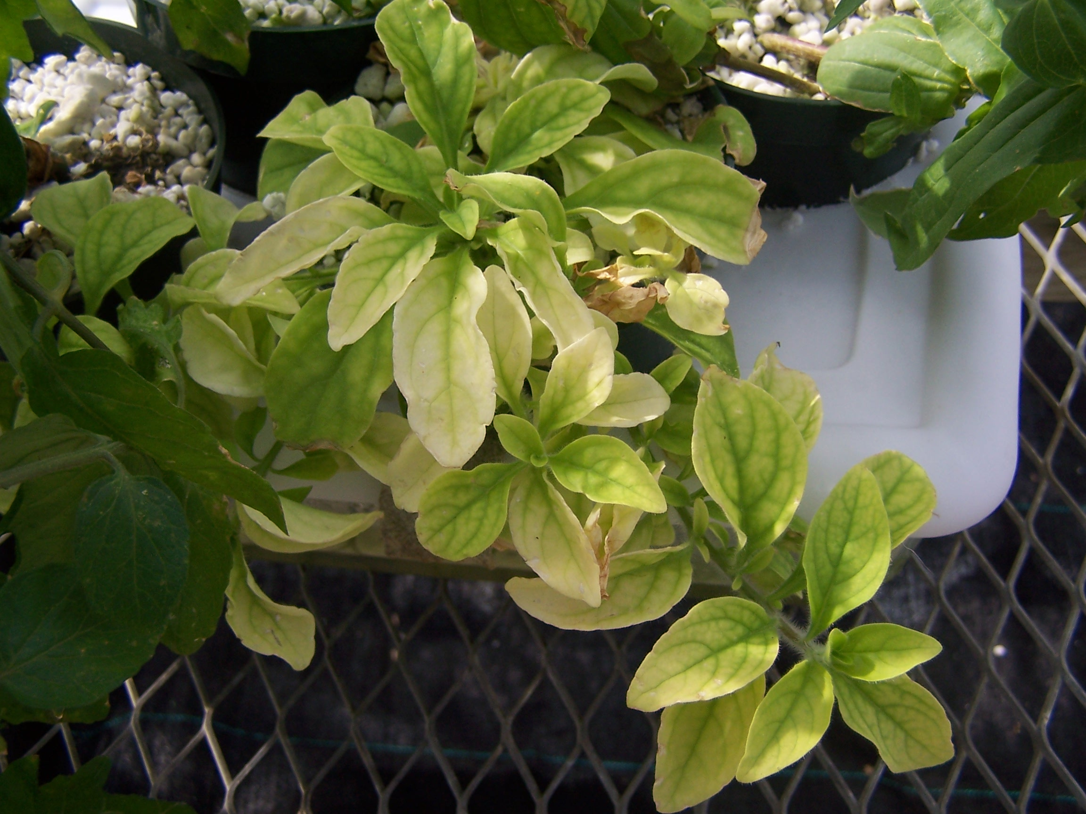
Interveinal chlorosis of the Extreme iron deficiency of
upper/younger leaves of this petunias! Note how some of the
zinnia. older leaves are nearly white!

Slide 46
MAGNESIUM NUTRITION AND DEFICIENCY SYMPTOMS
Magnesium, another macroelement, is used for the production of chlorophyll (the center atom of the chlorophyll molecule), is involved in enzymatic reactions within cells and is used for plant respiration.
Deficiency symptoms include lower leaves becoming chlorotic while younger leaves are not nearly as affected, and stunted growth.
Older leaves can take on a red/purplish cast after chlorosis begins and leaf margins can become necrotic.
Lower chlorotic leaves then become necrotic and fall off the plant.

Slide 47
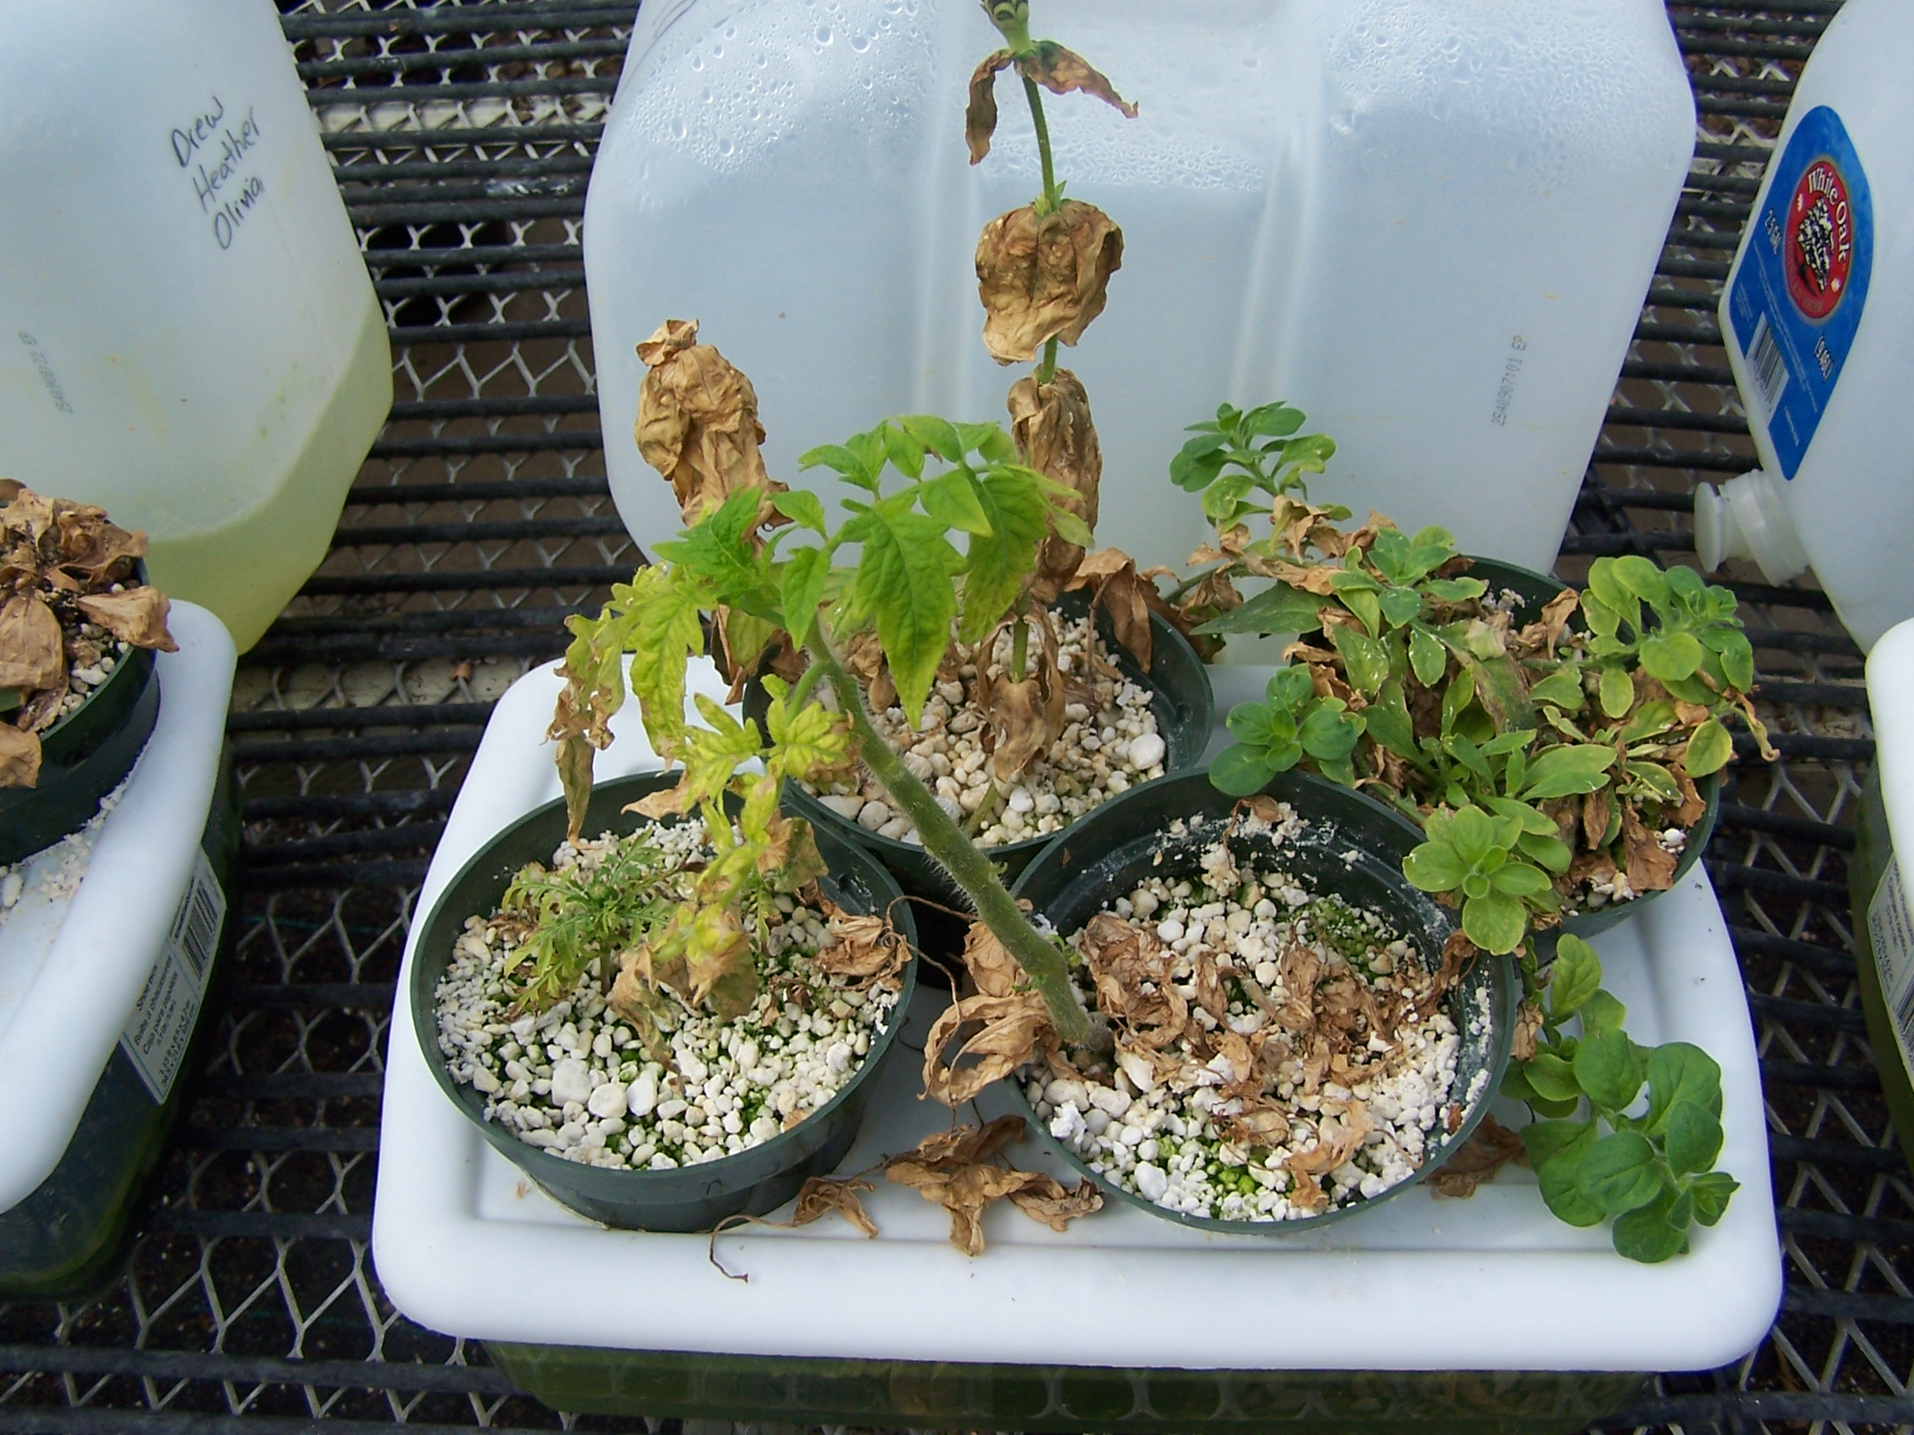
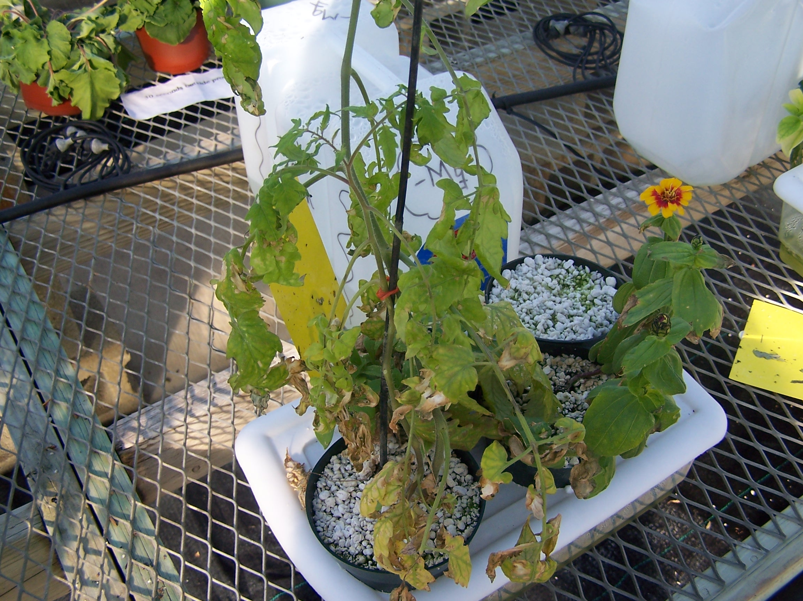
Note how the lower leaves in the left photo have mostly become necrotic with the lower tomato leaves having fallen off.
In the right photo, note how the upper leaves of the tomato are relatively green compared to the lower chlorotic leaves.

Slide 48
PHOSPHOROUS NUTRITION AND DEFICIENCY SYMPTOMS
Phosphorous, a macroelement, promotes root growth and flower & fruit development.
Also promotes disease resistance and serves as a component of ATP, the cell’s energy source.
Deficiency symptoms include stunted growth; purple pigmentation of lower leaves and stems, spreading up the plant; and necrosis of lower leaves.

Slide 49
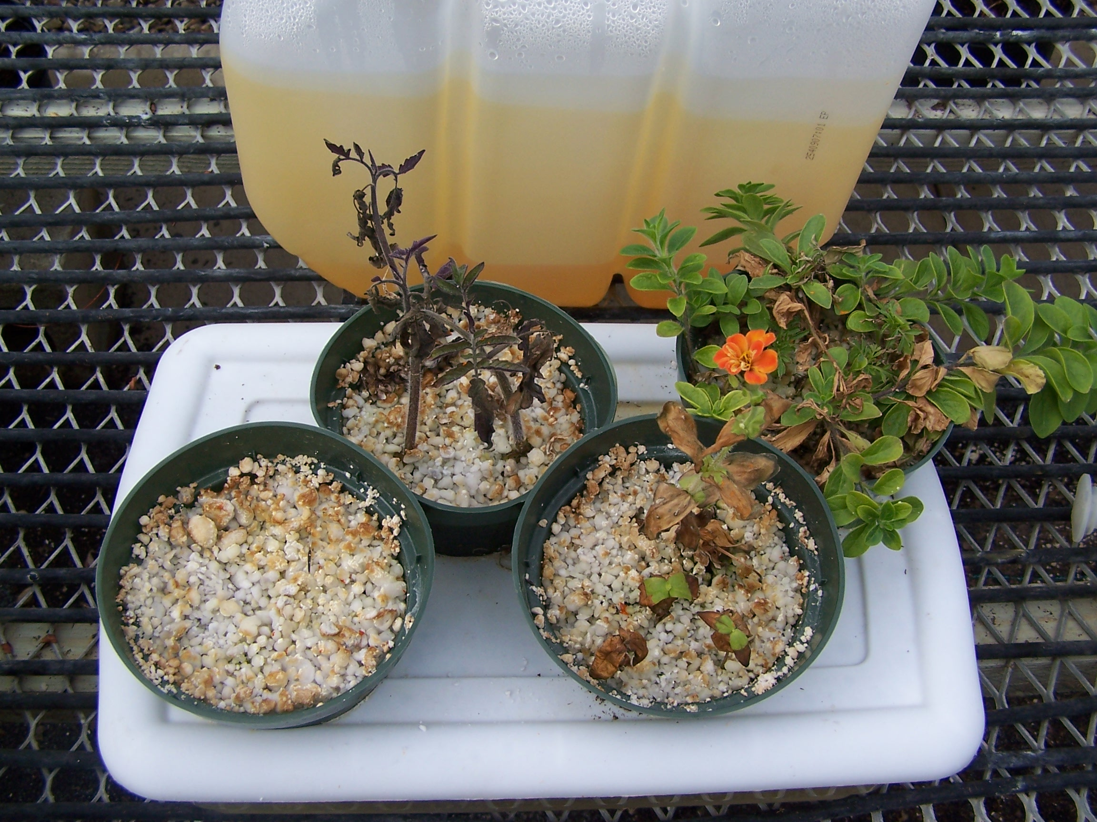
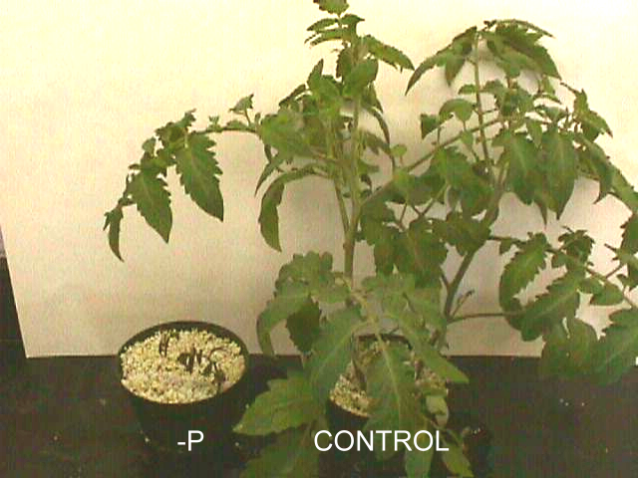
In the left photo, note the purple tomato plant, and the necrosis of the lower leaves in the petunia and severely stunted zinnias.
In the right photo, extremely stunted tomato next to the control plant!

Slide 50
Fertilizing tips
Apply complete fertilizers to supply both micro-and macroelements.
Garden soil pH ideally should be maintained between 6.2 and 6.8 while soilless media should be maintained between 5.4 and 6.4
Soil tests will show you nutrient and pH levels in the soil and tips on correcting deficient or excessive nutrient/pH levels.
Epsom salts (magnesium sulfate) is a good source of Mg and S
Limestone and dolomitic limestone is a good source of Ca and is used to raise soil pH; dolomitic limestone also supplies Mg.
Iron sulfate is used to lower soil pH and is a good source of Fe.

Slide 51
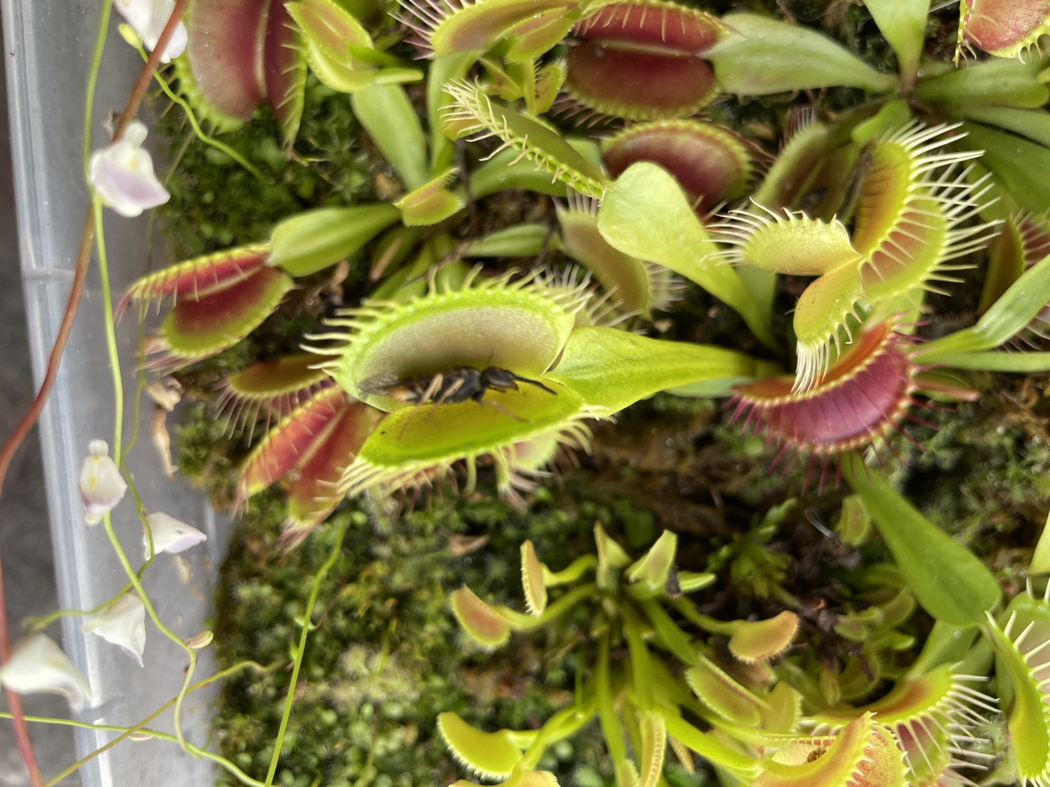
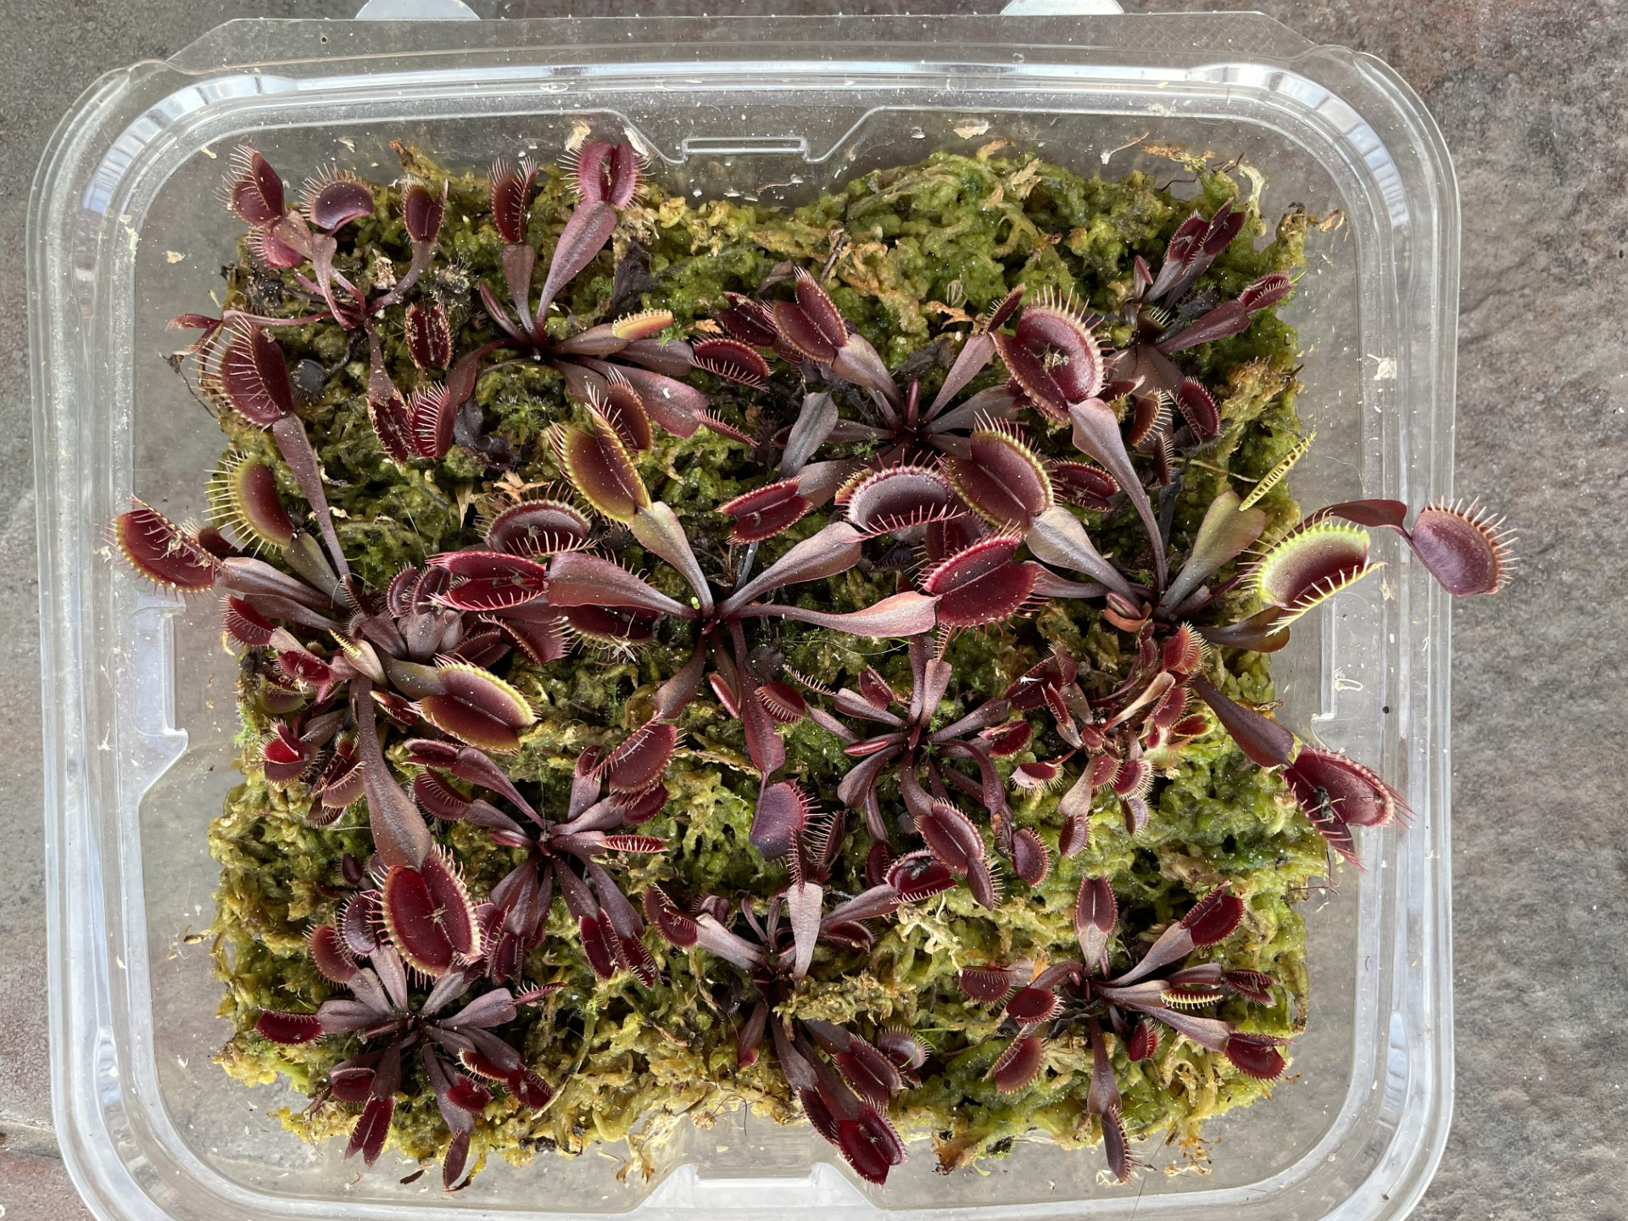
QUESTIONS?

